Slide 1

New York State Regents Examination in
English Language Arts
(Common Core)
Session IV:
Part 3 – Text Analysis: Exposition
Scorer Training

Slide 2
Part 3- Text Analysis: Exposition
What to Expect
Section 1 - Blueprint
Section 2 - Task and Passage
Section 3 - Rubric
Section 4 - Sample Responses and Annotations

Slide 3
Materials Needed for
Training
Part 3 Teacher’s Packet includes:
  Task
  Sample Text
  Rubric
  Anchor Set Papers with Annotations
  Practice Set Papers with Annotations
(The Teacher’s Packet is posted with this webcast.)

Slide 4
Section 1
Blueprint of the
Part 3- Text-Analysis: Exposition
Task

Slide 5
Part 3- Text Analysis: Exposition
Blueprint
Test Part | Suggested Time | Standards Addressed | Text Description | Student Task
Part 3 Text Analysis: Exposition | 30 minutes | RL.1-6, 10 RI.1‐6, 8-10 W.2, 4, 9 L.1‐6 | 1 text Up to approximately 1,000 words Each test will contain one literature or one informational text. | Students will perform a close reading of the text and write a two-to-three paragraph expository response that identifies a central idea in the text and analyses how the author’s use of one writing strategy (literary element or literary technique or rhetorical device) develops this central idea.

Slide 6
Section 2
Part 3- Text-Analysis: Exposition
Task

Slide 7
Directions for Reviewing Sample Text
Read the text John F. Kennedy Inaugural Address independently
Plan a response based on the Part 3 Sample Task
Compare responses

Slide 8
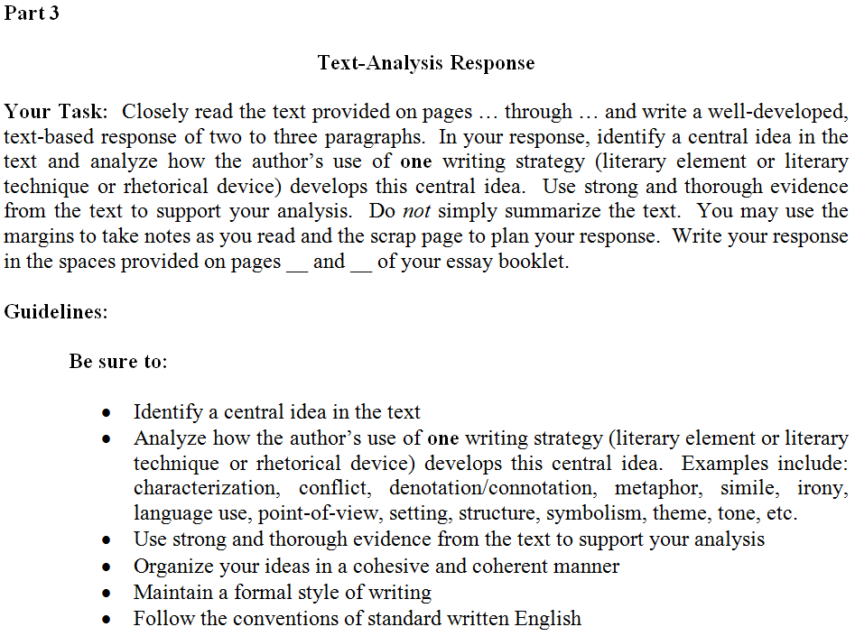
Sample Task
.

Slide 9
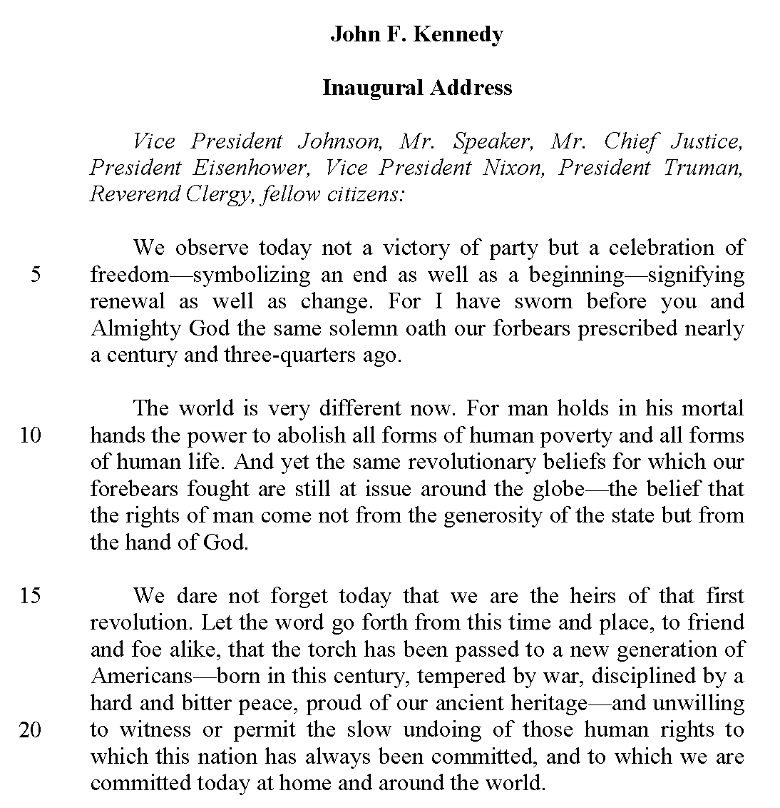
Text

Slide 10
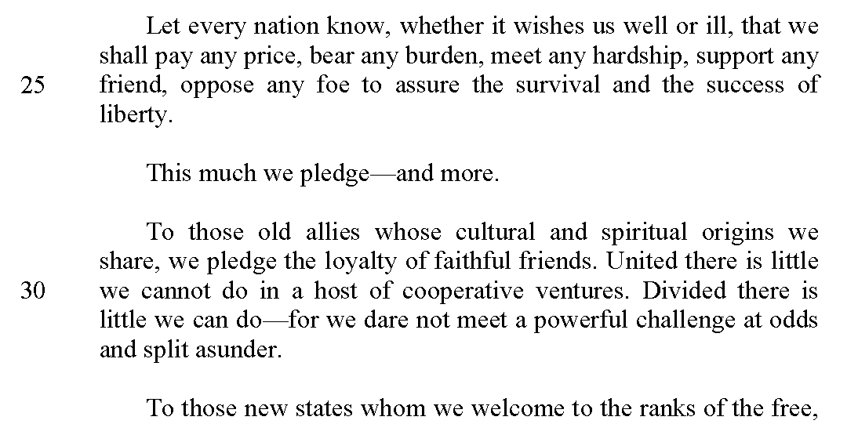
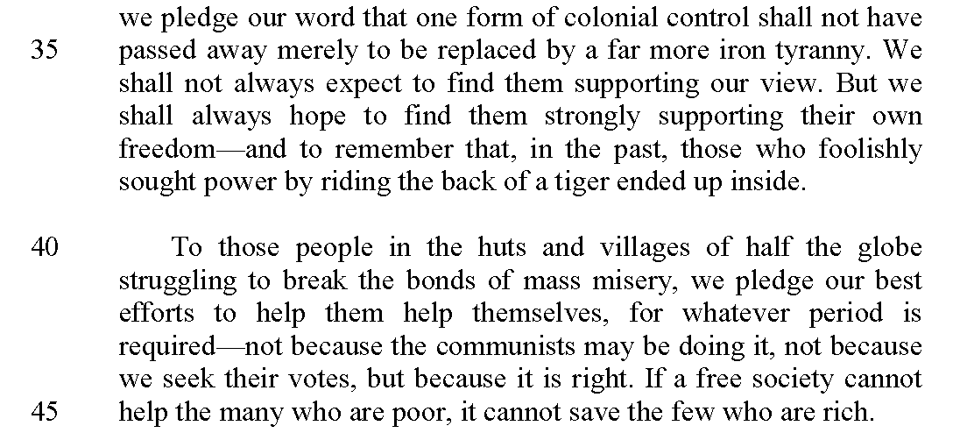

Slide 11
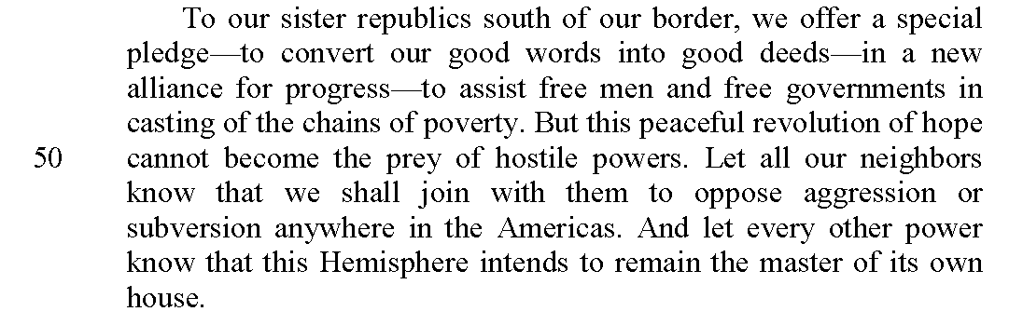
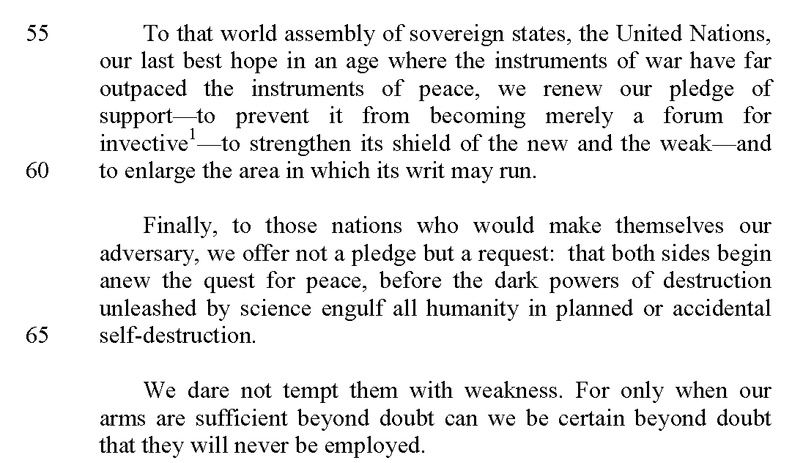

Slide 12
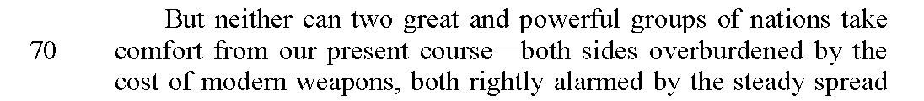
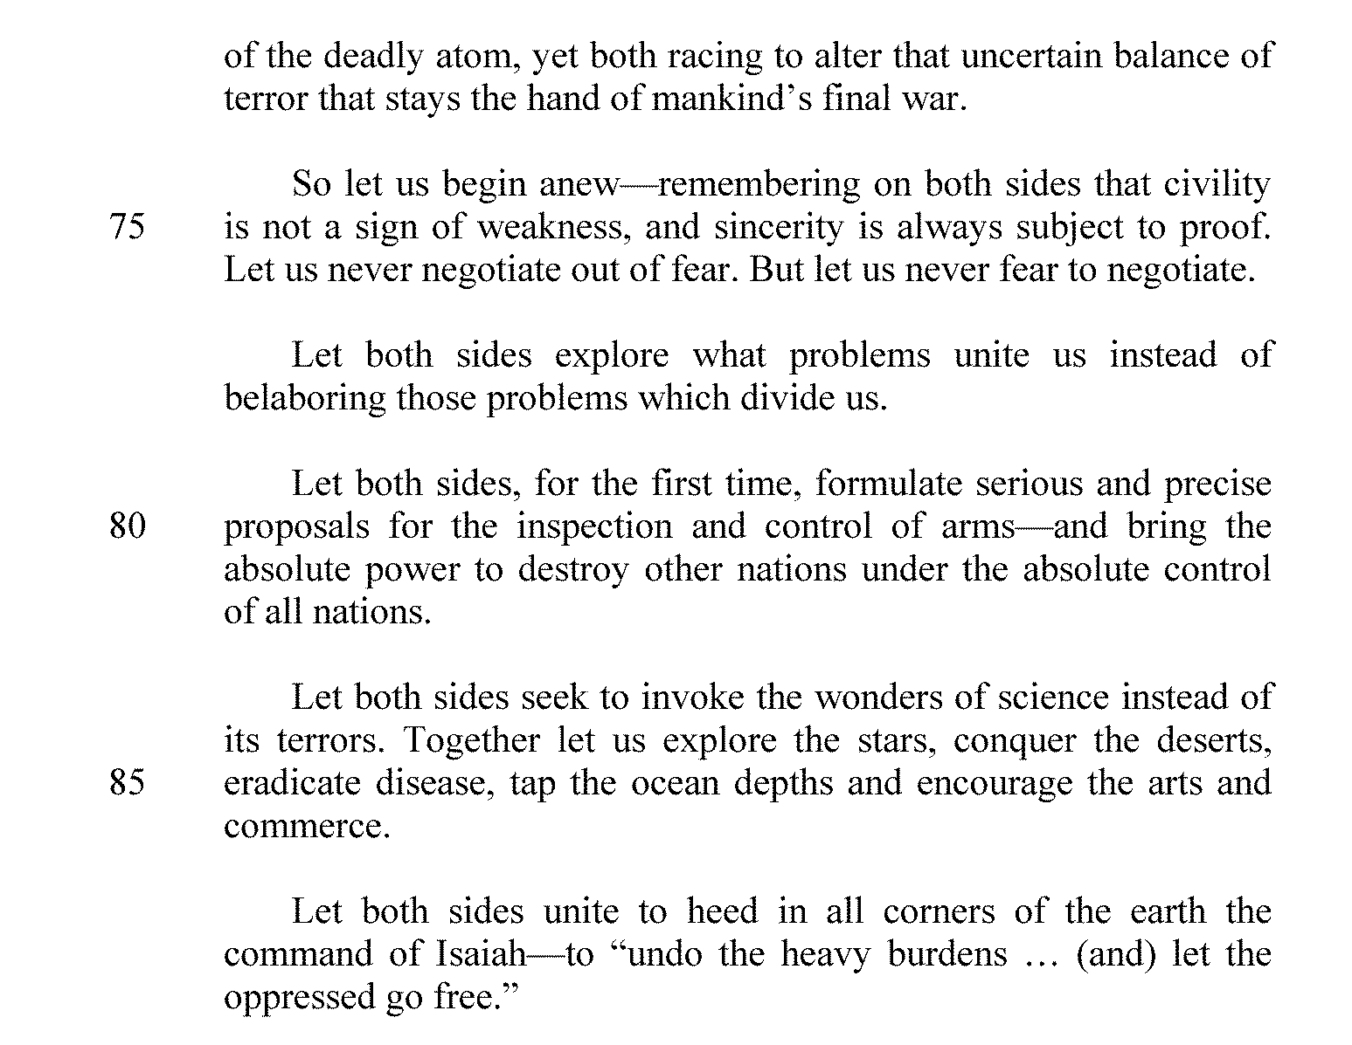

Slide 13
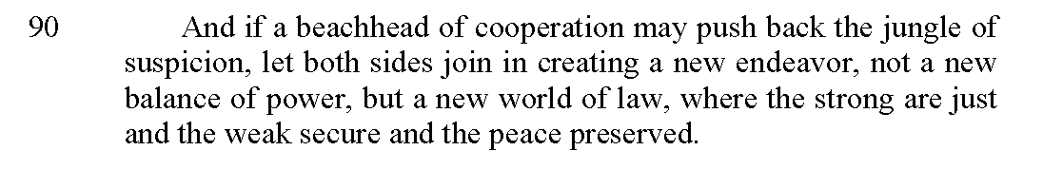
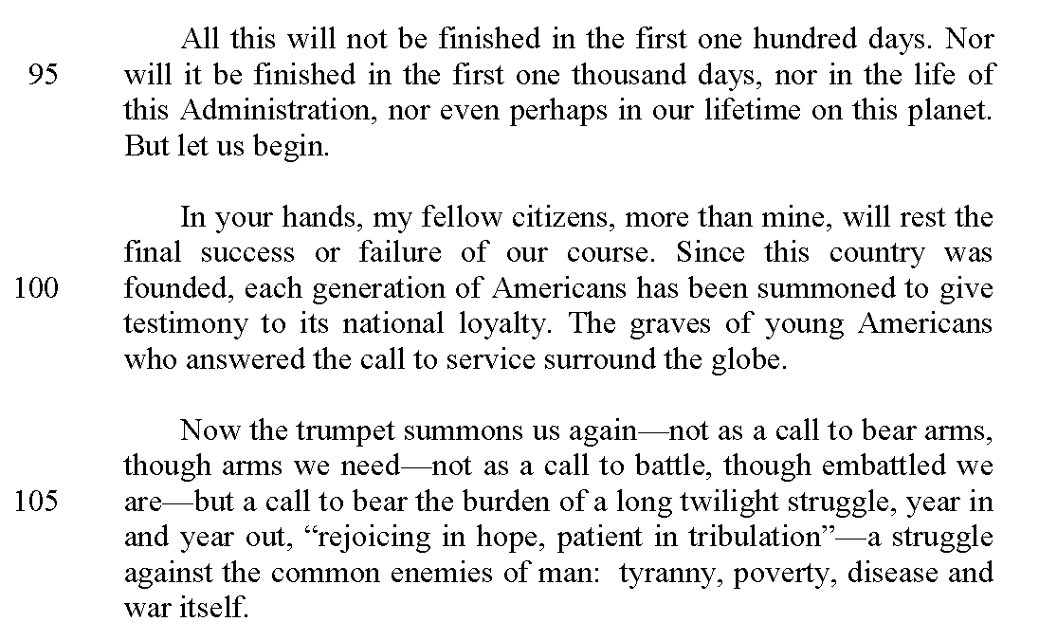
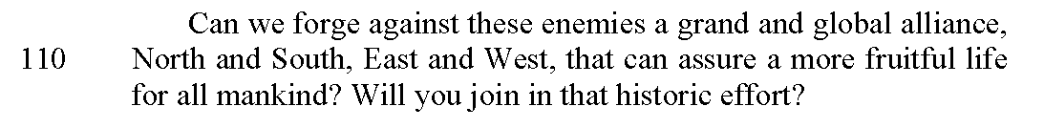

Slide 14
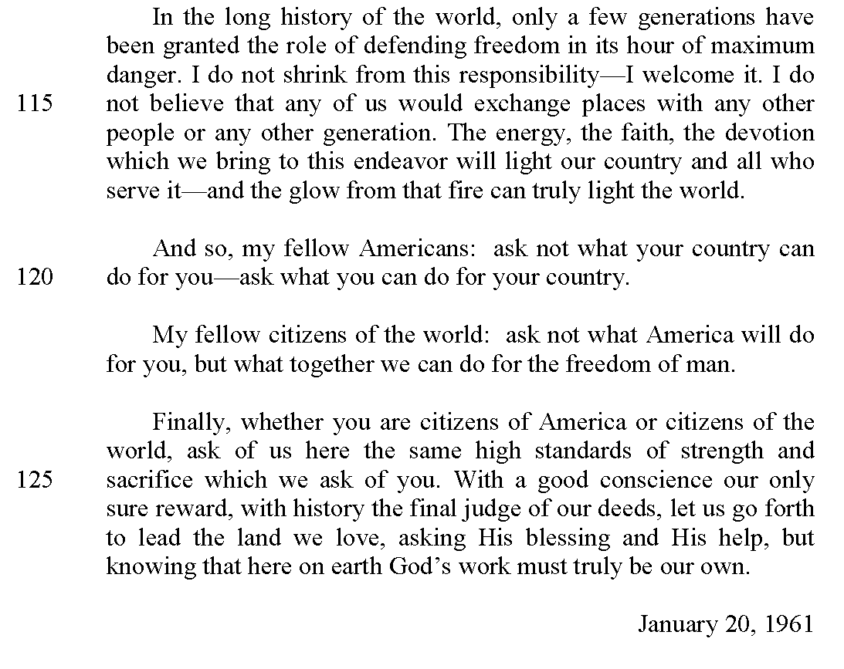
-John F. Kennedy
excerpted from his Inaugural Address
delivered at Washington, D.C., January 20,1961

Slide 15
Section 3
Rubric for the
Part 3- Text-Analysis: Exposition
Task

Slide 16
Scoring Information
The Text Analysis: Exposition response is rated using a 4-credit rubric.
The rubric is specific to Part 3 and should be used holistically when rating student responses.

Slide 17
Holistic Scoring
Holistic scorers:
  evaluate the paper based on its overall quality as specified by the rubric criteria
  consider the paper as a total work where the whole is greater than the sum of its parts
  read supportively, looking for and rewarding those things done well in the response
  do not focus on identification of weakness or errors in the paper but rather focus on overall quality
  do not consider one criteria contributing more weight to the score than another

Slide 18
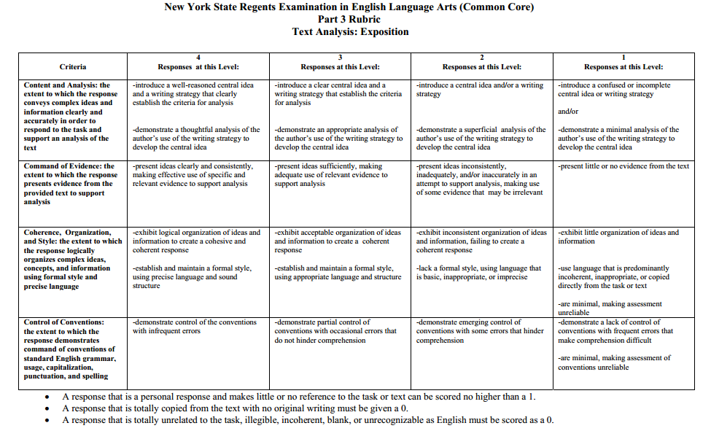

Slide 19
Part 3- Rubric Condition Codes
A response that is a personal response and makes little or no reference to the task or text can be scored no higher than a 1.
A response that is totally copied from the text with no original writing must me given a 0.
A response that is totally unrelated to the task, illegible, incoherent, blank, or unrecognizable as English must be scored as a 0.

Slide 20
Part 3- Text Analysis: Exposition
Rubric Levels: Content and Analysis
Criteria | 4 Responses at this Level: | 3 Responses at this Level: | 2 Responses at this Level: | 1 Responses at this Level:
Content and Analysis: the extent to which the response conveys complex ideas and information clearly and accurately in order to respond to the task and support an analysis of the text | -introduce a well-reasoned central idea and a writing strategy that clearly establish the criteria for analysis -demonstrate a thoughtful analysis of the author’s use of the writing strategy to develop the central idea | -introduce a clear central idea and a writing strategy that establish the criteria for analysis -demonstrate an appropriate analysis of the author’s use of the writing strategy to develop the central idea | -introduce a central idea and/or a writing strategy -demonstrate a superficial analysis of the author’s use of the writing strategy to develop the central idea | -introduce a confused or incomplete central idea or writing strategy and/or -demonstrate a minimal analysis of the author’s use of the writing strategy to develop the central idea

Slide 21
Part 3- Text Analysis: Exposition
Rubric Levels: Command of Evidence
Criteria | 4 Responses at this Level: | 3 Responses at this Level: | 2 Responses at this Level: | 1 Responses at this Level:
Command of Evidence: the extend to which the response presents evidence from the provided text to support analysis | -present ideas clearly and consistently, making effective use of specific and relevant evidence to support analysis | -present ideas sufficiently, making adequate use of relevant evidence to support analysis | -present ideas inconsistently, inadequately, and/or inaccurately in an attempt to support analysis, making use of some evidence that may be irrelevant | -present little or no evidence from the text

Slide 22
Part 3- Text Analysis: Exposition
Rubric Levels: Coherence, Organization, and Style
Criteria | 4 Responses at this Level: | 3 Responses at this Level: | 2 Responses at this Level: | 1 Responses at this Level:
Coherence, Organization, and Style: the extent to which the response logically organizes complex ideas, concepts, and information using formal style and precise language | -exhibit logical organization of ideas and information to create a cohesive and coherent response -establish and maintain a formal style, using precise language and sound structure | -exhibit acceptable organization of ideas and information to create a coherent response -establish and maintain a formal style, using appropriate language and structure | -exhibit inconsistent organization of ideas and information, failing to create a coherent response -lack a formal style, using language that is basic, inappropriate, or imprecise | -exhibit little organization of ideas and information -use language that is predominantly incoherent, inappropriate, or copied directly from the task or text -are minimal, making assessment unreliable

Slide 23
Part 3- Text Analysis: Exposition
Rubric Levels: Control of Conventions
Criteria | 4 Responses at this Level: | 3 Responses at this Level: | 2 Responses at this Level: | 1 Responses at this Level:
Control of Conventions: the extent to which the response demonstrates command of conventions of standard English grammar, usage, capitalization, punctuation, and spelling | -demonstrate control of the conventions with infrequent errors | -demonstrate partial control of conventions with occasional errors that do not hinder comprehension | -demonstrate emerging control of conventions with some errors that hinder comprehension | -demonstrate a lack of control of conventions with frequent errors that make comprehension difficult -are minimal, making assessment of conventions unreliable

Slide 24
Section 4
Sample Student Responses for the
Part 3- Text-Analysis: Exposition
Task

Slide 25
Directions for Reviewing Anchor and Practice Papers
Briefly review the text, John F. Kennedy Inaugural Address
Review each Anchor Paper one at a time along with its accompanying annotation
When review of the Anchor Papers is completed, score each of the 5 Practice Papers
Compare your scores with the Practice Paper Annotations

Slide 26
Sample Responses:
Anchor and Practice Papers
Anchor papers are examples of student responses at particular score points.
Practice papers are used to confirm that scorers understand the rubric and scoring rationale.
Annotations are commentaries that explain the holistically assigned score point.

Slide 27
Anchor Papers

Slide 28
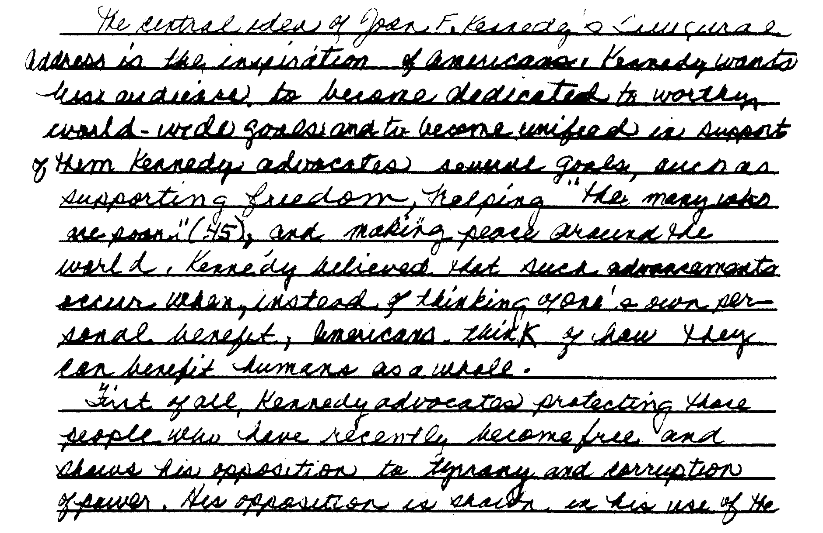
Anchor Paper – Part 3 – Level 4 – A

Slide 29
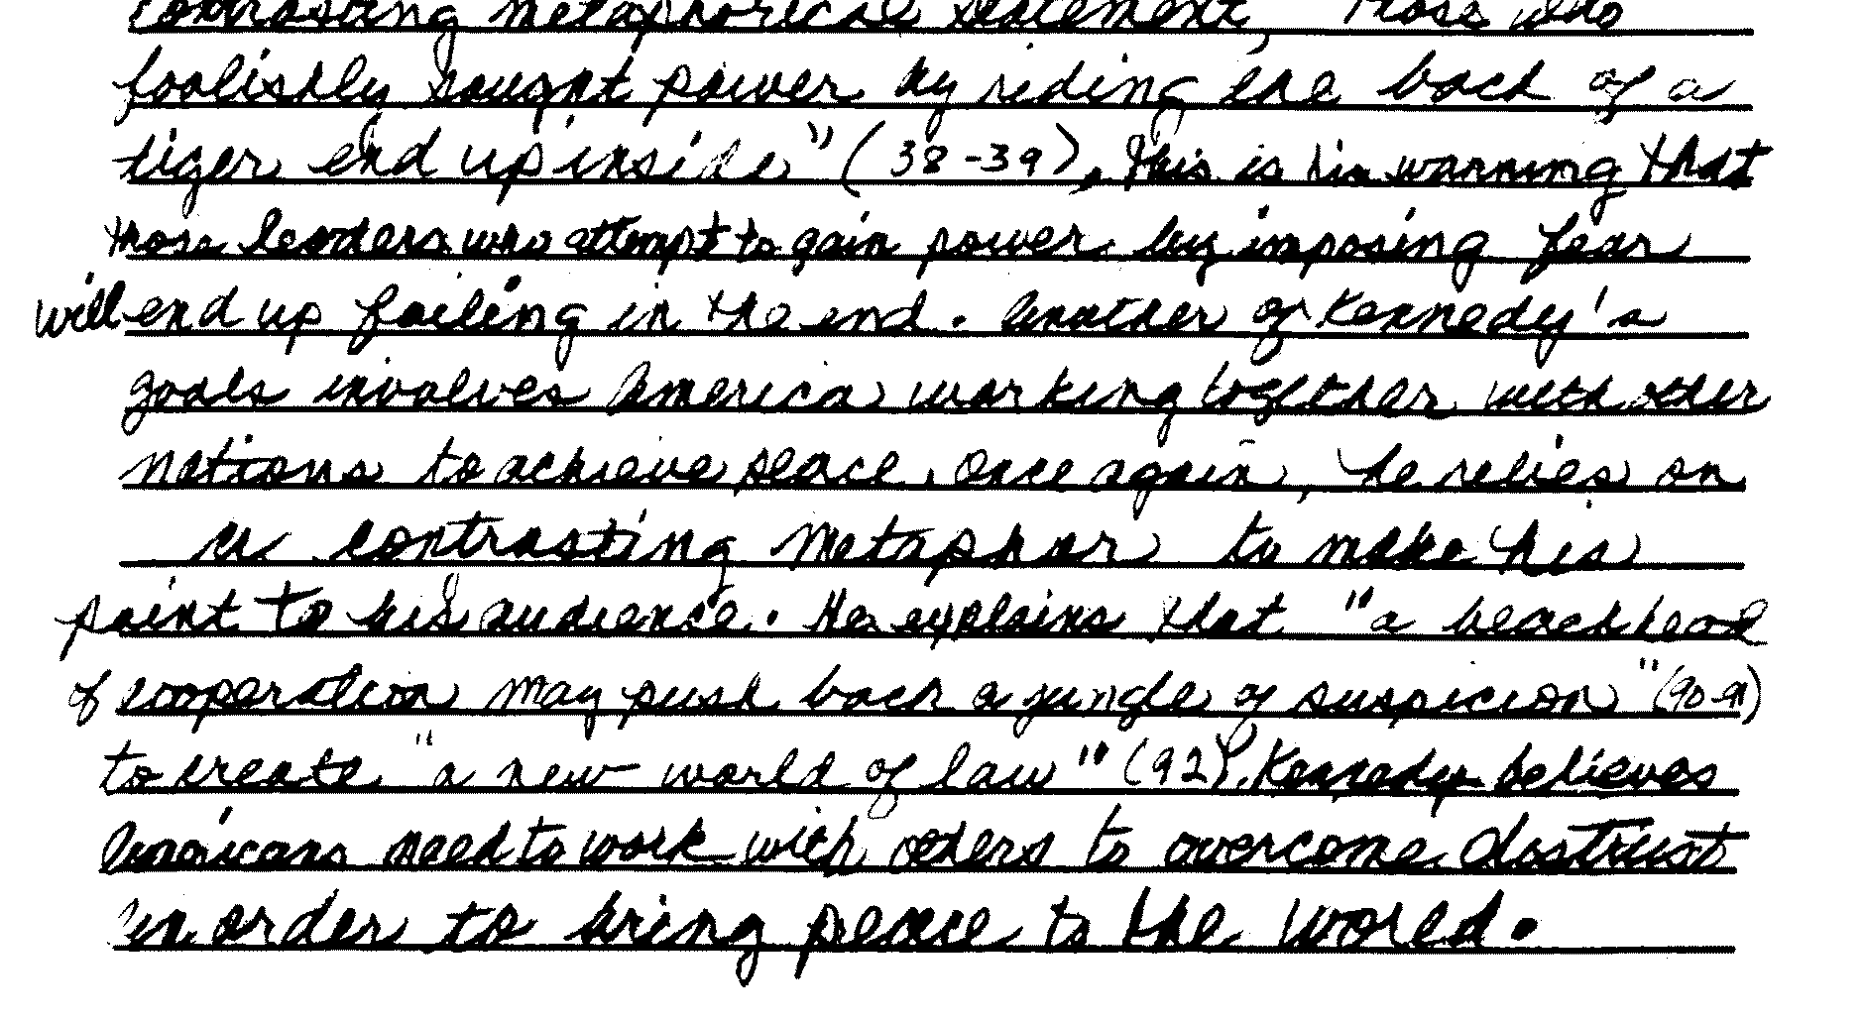
Anchor Paper – Part 3 – Level 4 – A
(continued)

Slide 30
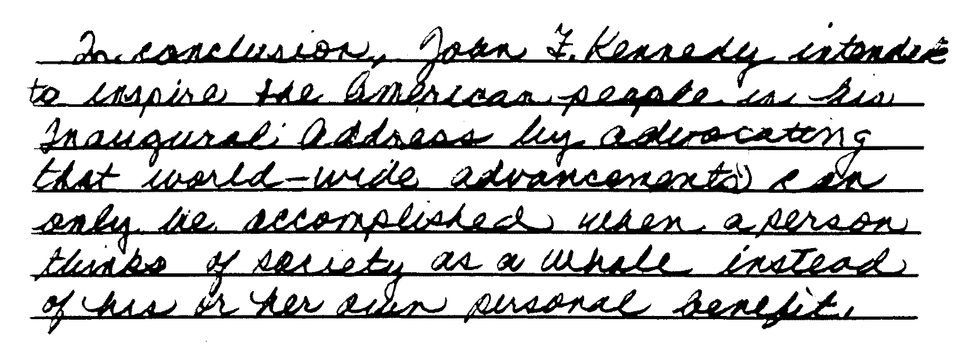
Anchor Paper – Part 3 – Level 4 – A
(continued)

Slide 31
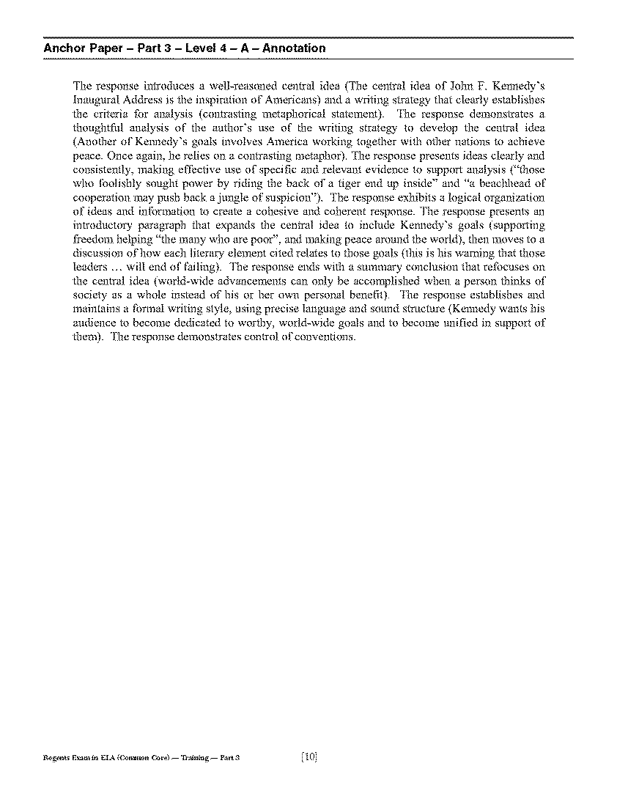
Anchor Paper- Part 3- Level 4- A Annotation
Please refer to page 10 of your Teacher’s Packet.

Slide 32
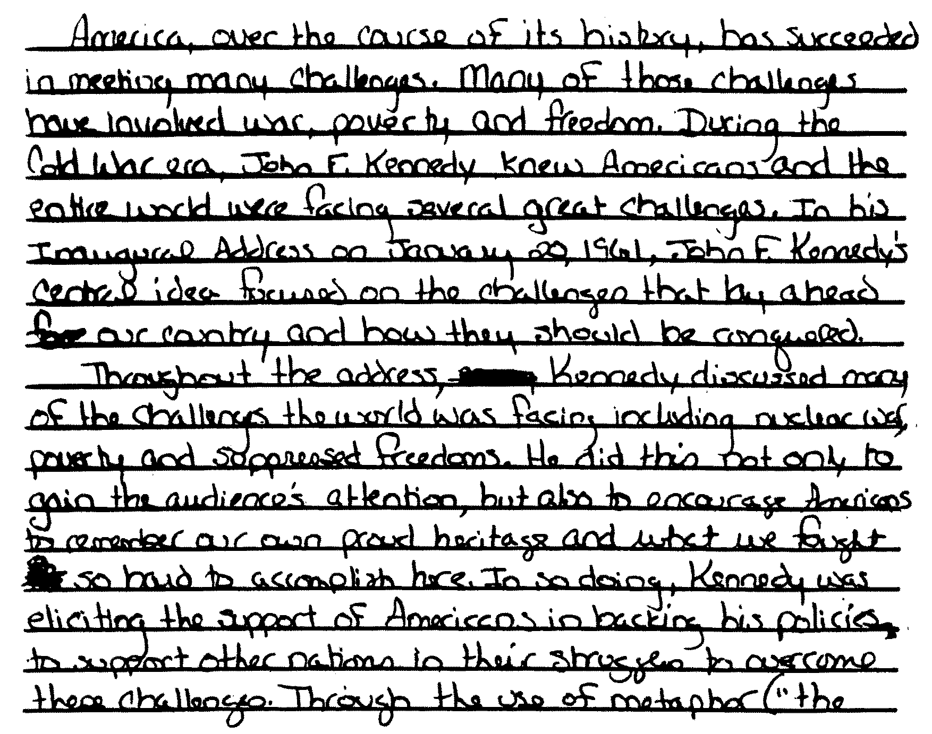
Anchor Paper – Part 3 – Level 4 – B

Slide 33
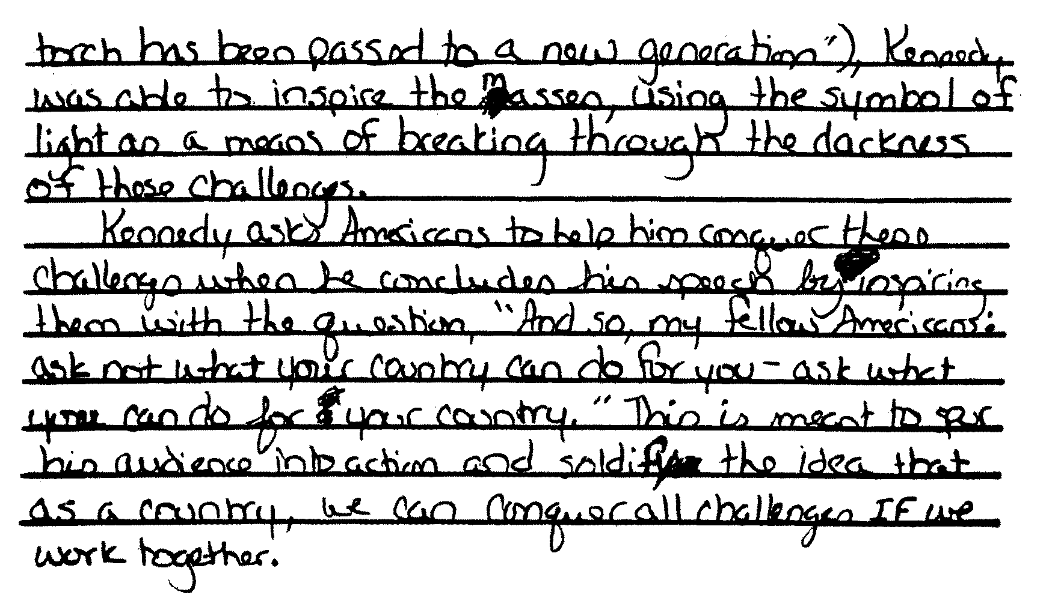
Anchor Paper – Part 3 – Level 4 – B
(continued)

Slide 34
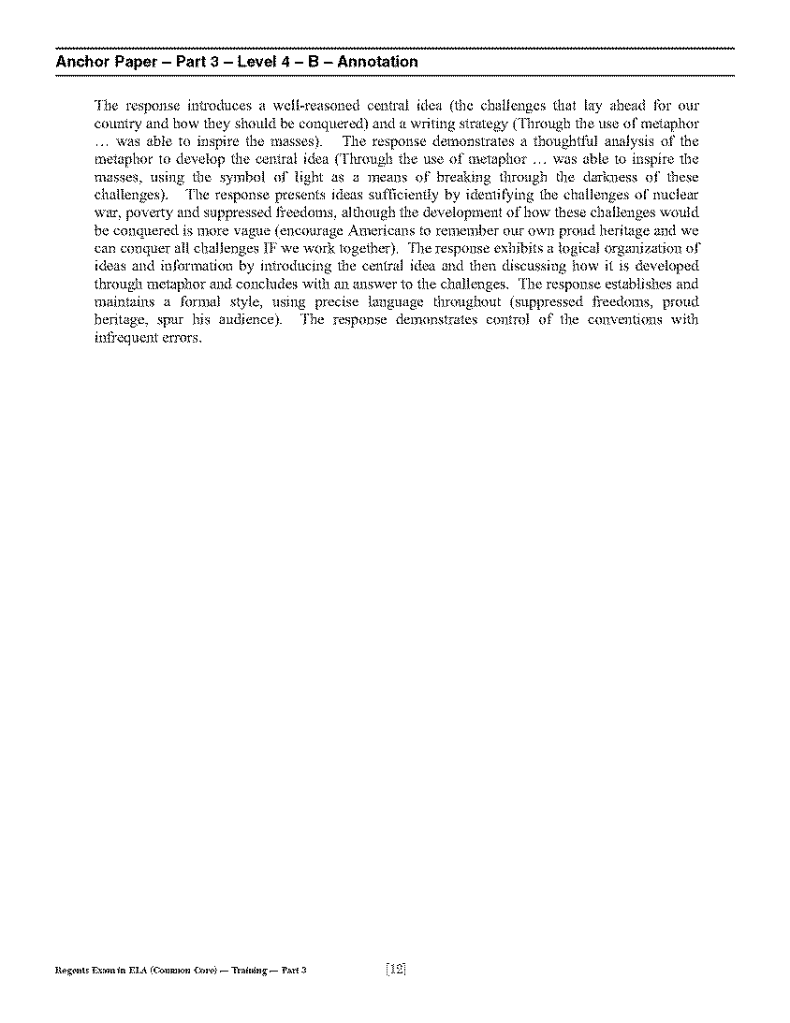
Anchor Paper- Part 3- Level 4- B Annotation
Please refer to page 12 of your Teacher’s Packet.

Slide 35
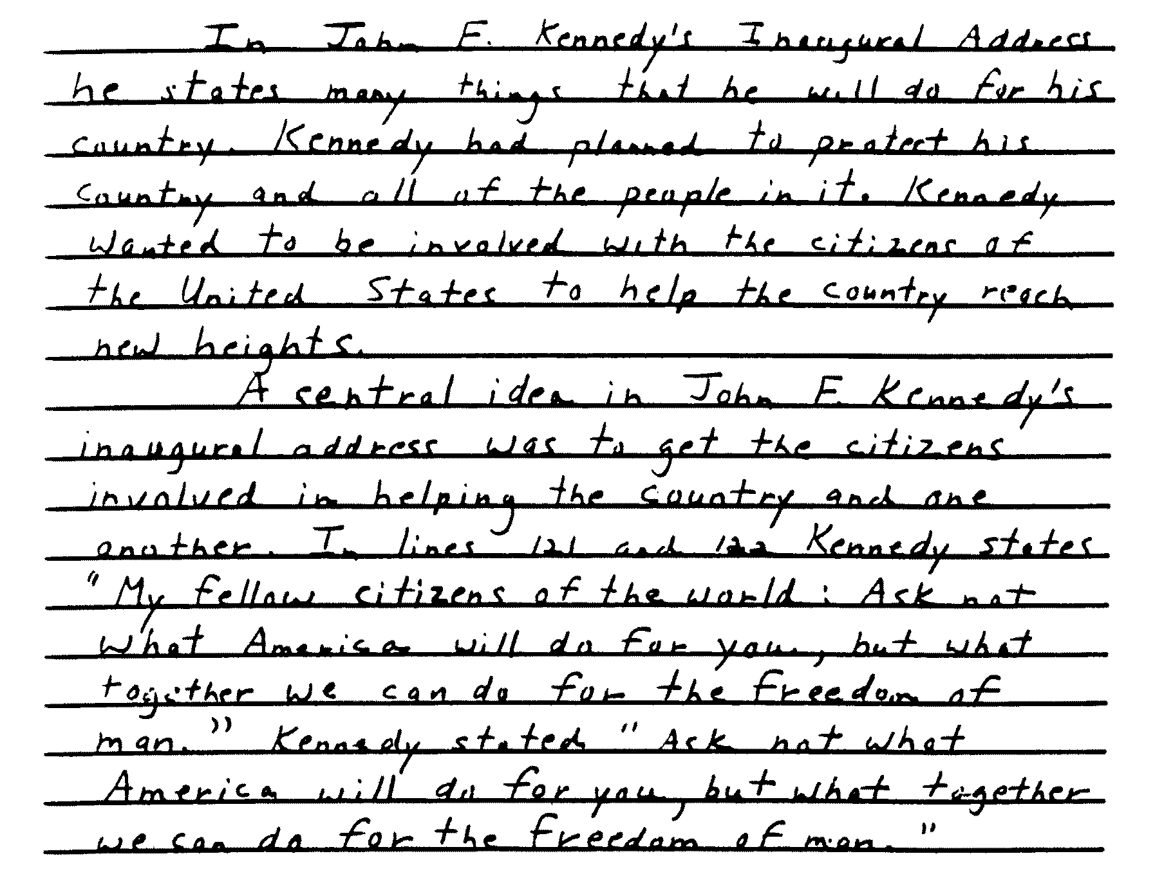
Anchor Paper – Part 3 – Level 3 – A

Slide 36
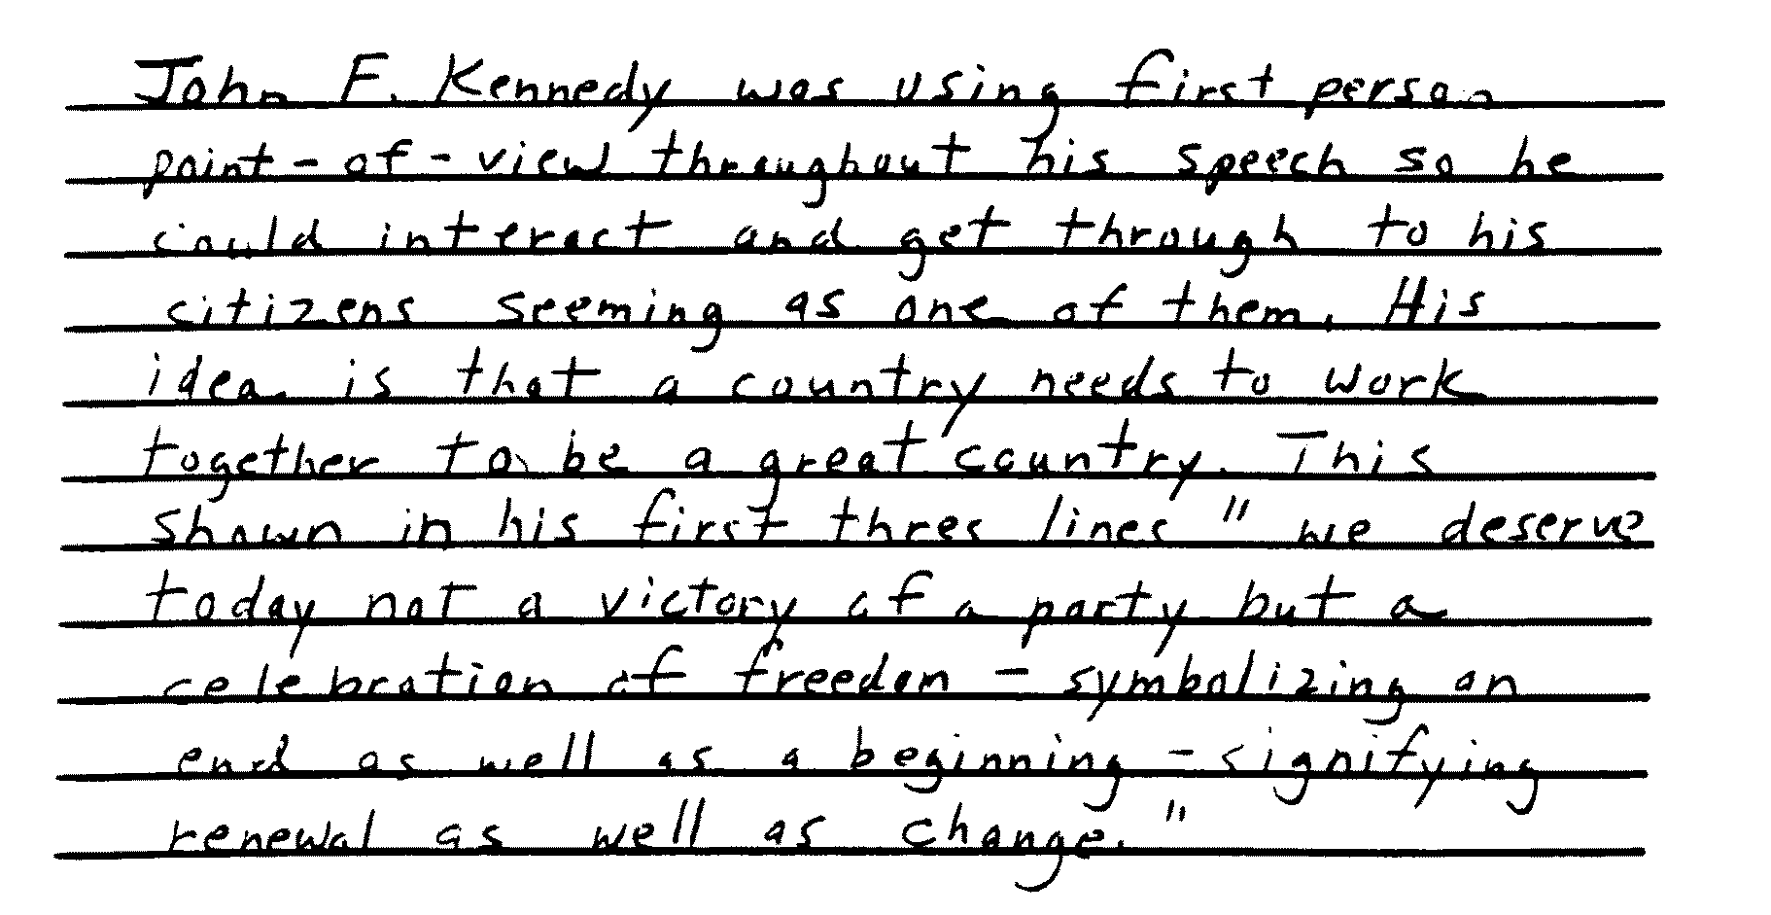
Anchor Paper – Part 3 – Level 3 – A
(continued)

Slide 37
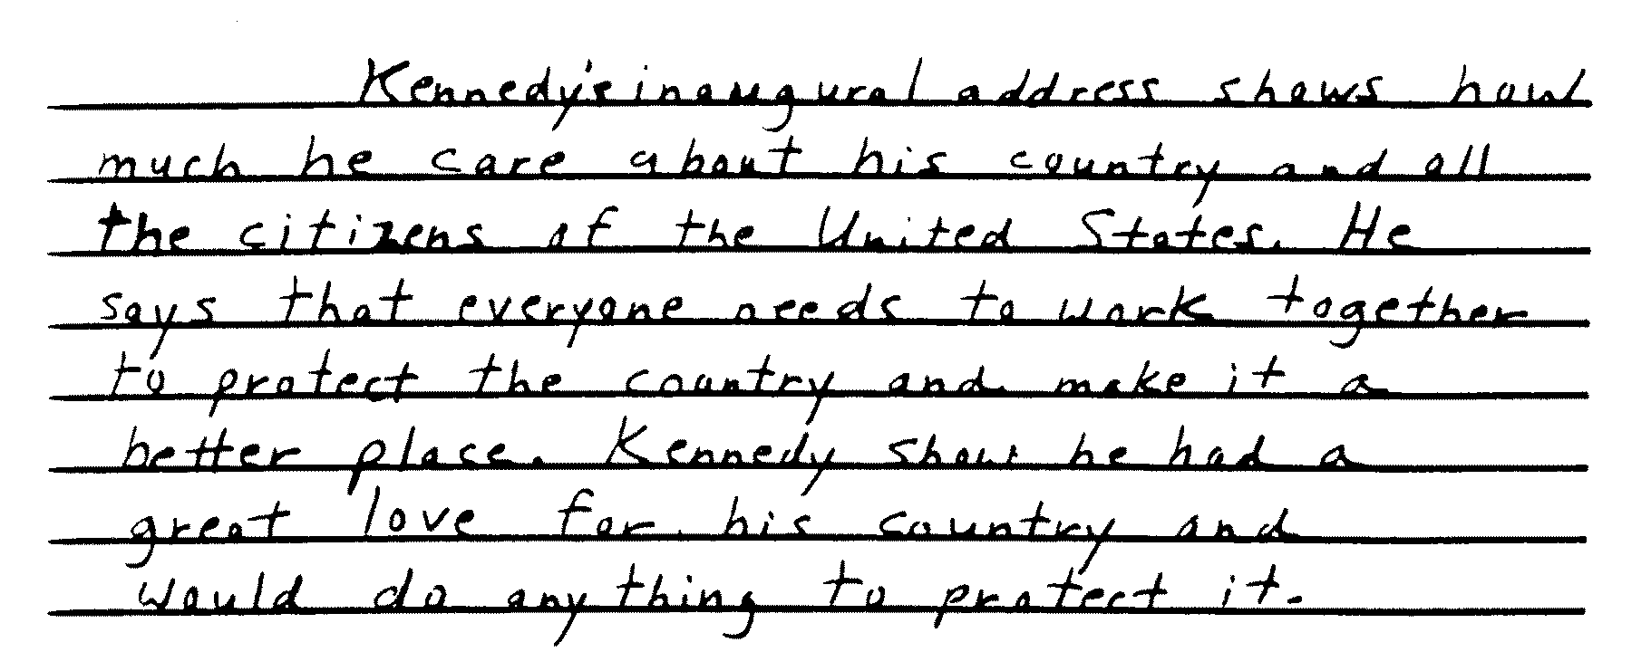
Anchor Paper – Part 3 – Level 3 – A
(continued)

Slide 38
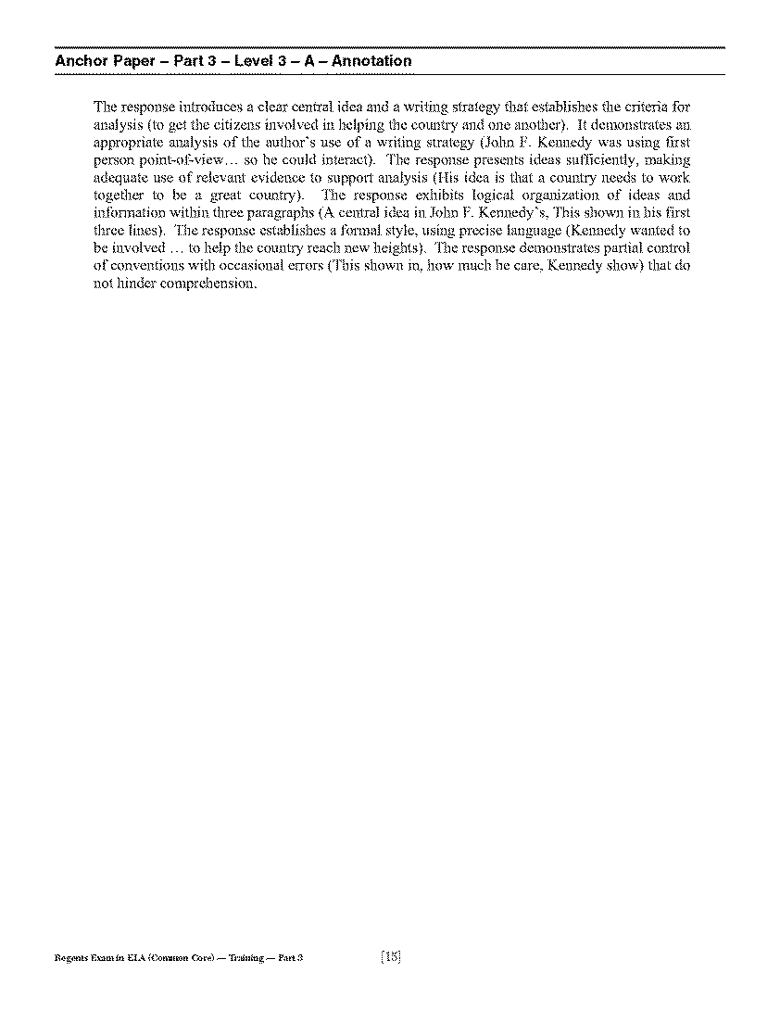
Anchor Paper 3- Part 3- Level 3- A Annotation
Please refer to page 15 of your Teacher’s Packet.

Slide 39
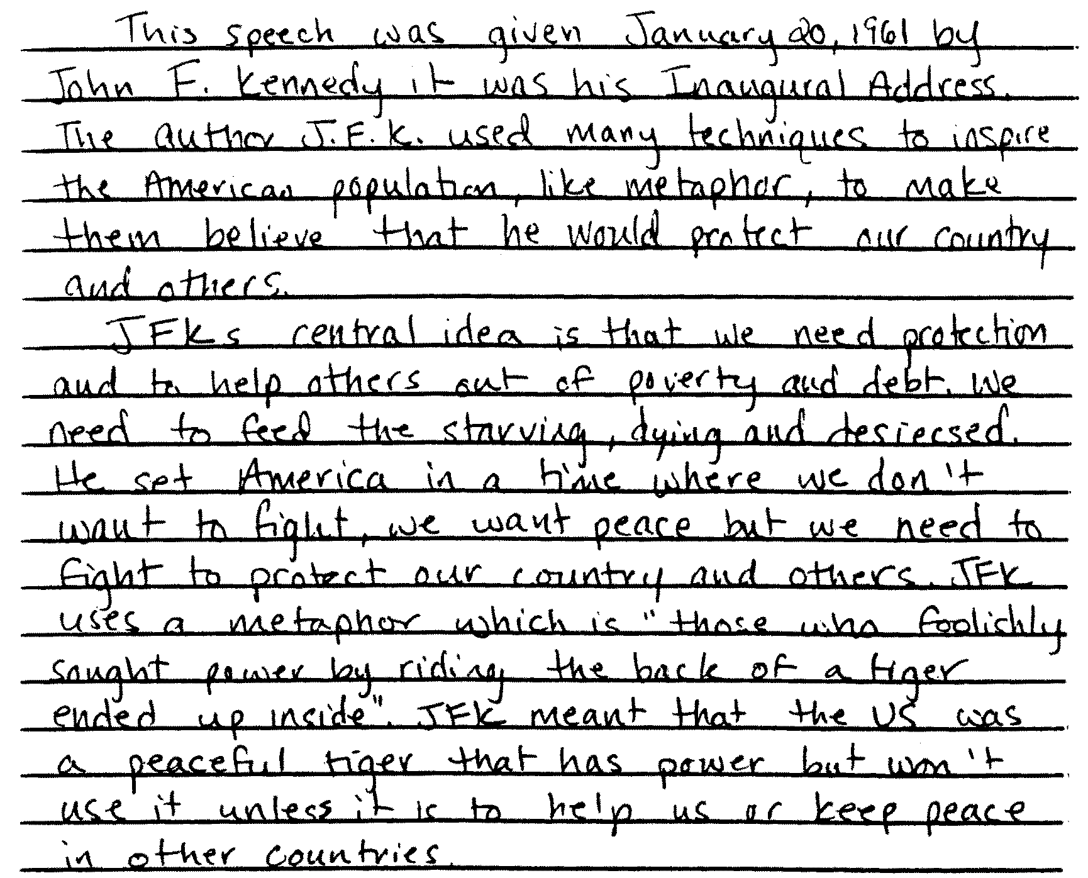
Anchor Paper – Part 3 – Level 3 – B

Slide 40
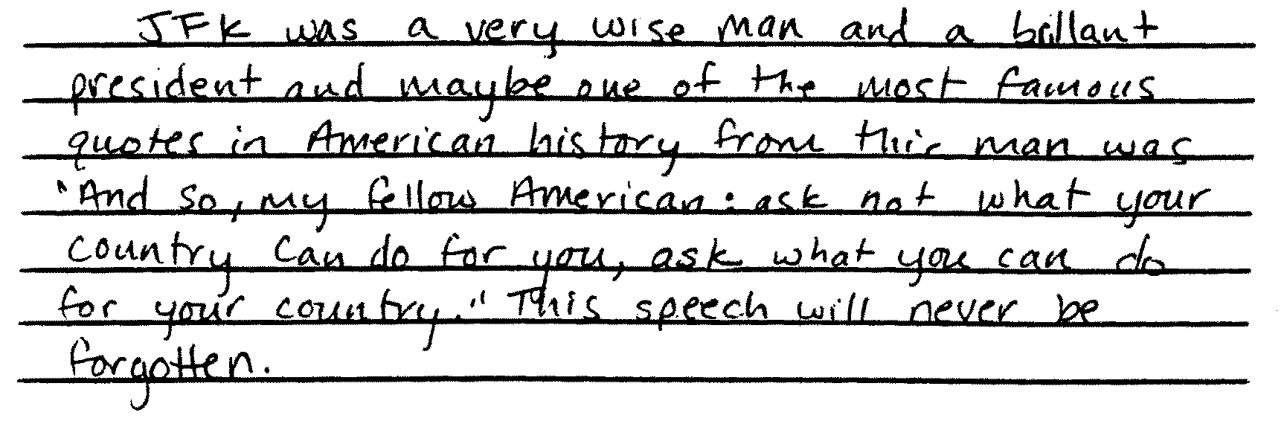
Anchor Paper – Part 3 – Level 3 – B
(continued)

Slide 41
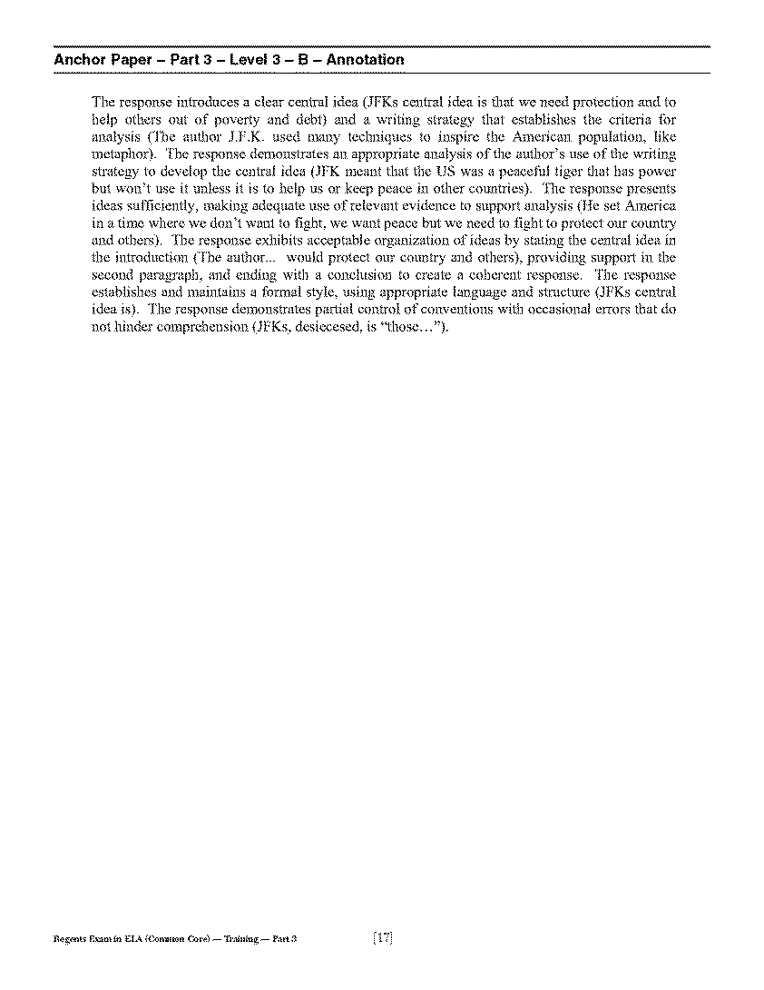
Anchor Paper- Part 3- Level 3- B Annotation
Please refer to page 17 of your Teacher’s Packet.

Slide 42
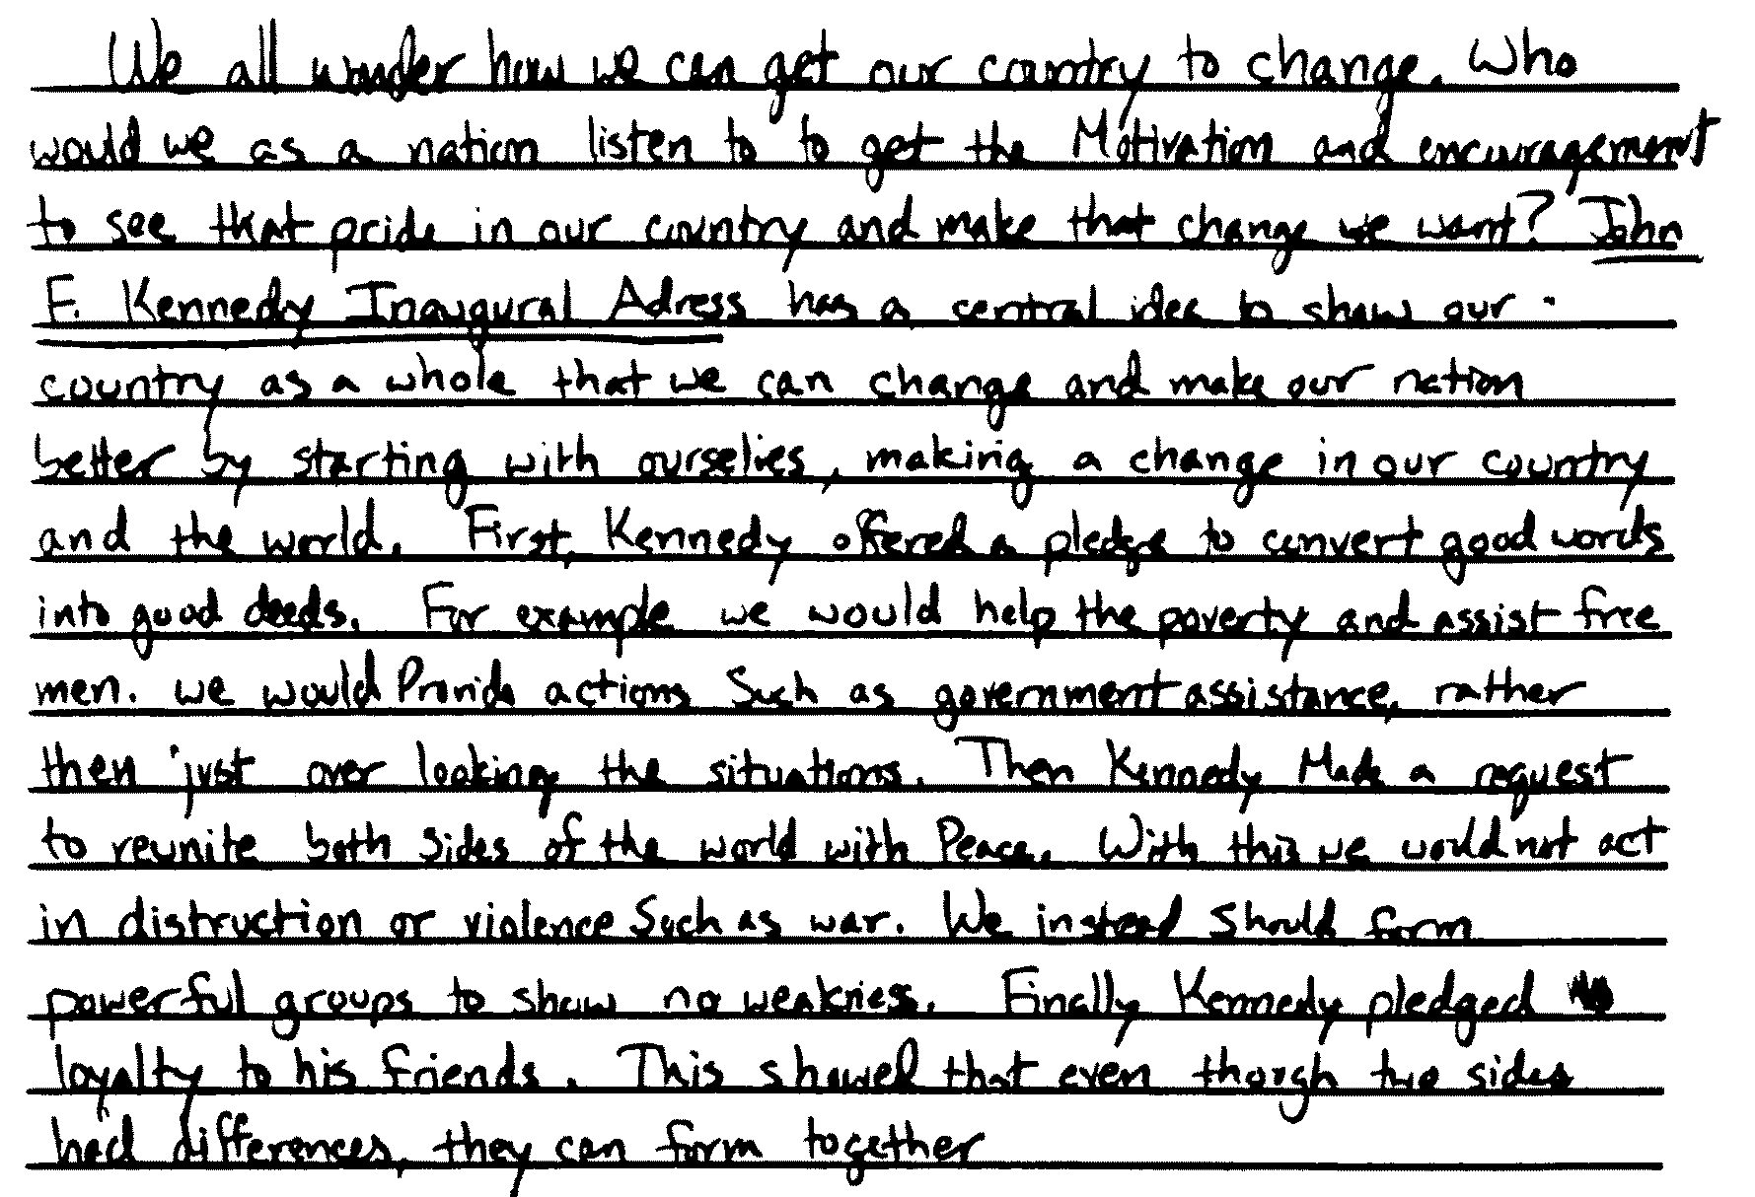
Anchor Paper – Part 3 – Level 3 – C

Slide 43
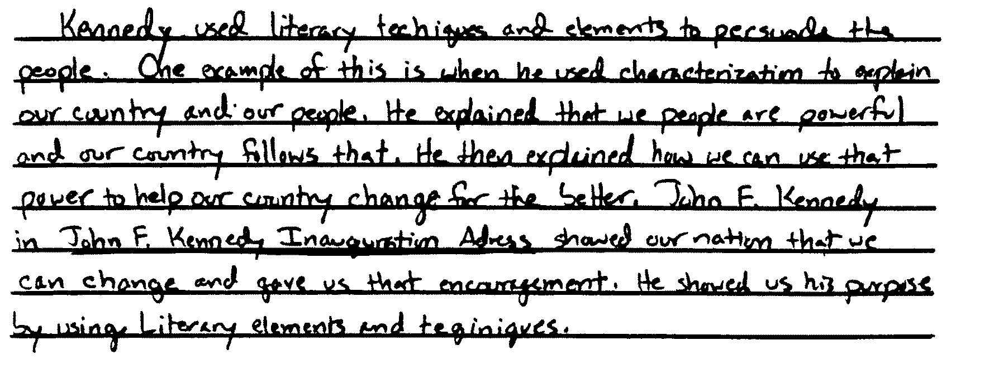
Anchor Paper – Part 3 – Level 3 – C
(continued)

Slide 44
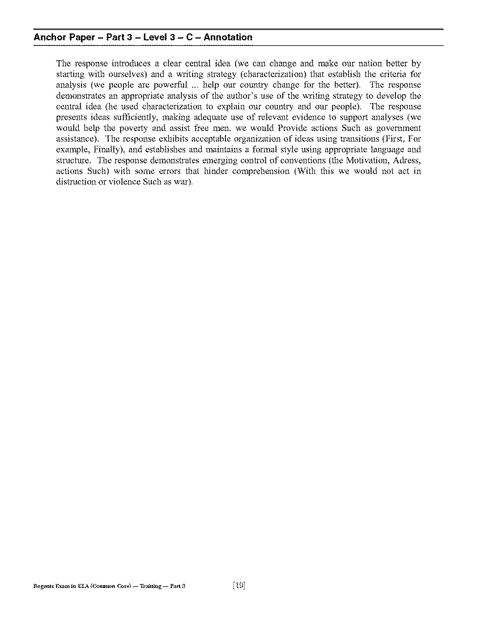
Anchor Paper- Part 3- Level 3- C Annotation
Please refer to page 19 of your Teacher’s Packet.

Slide 45
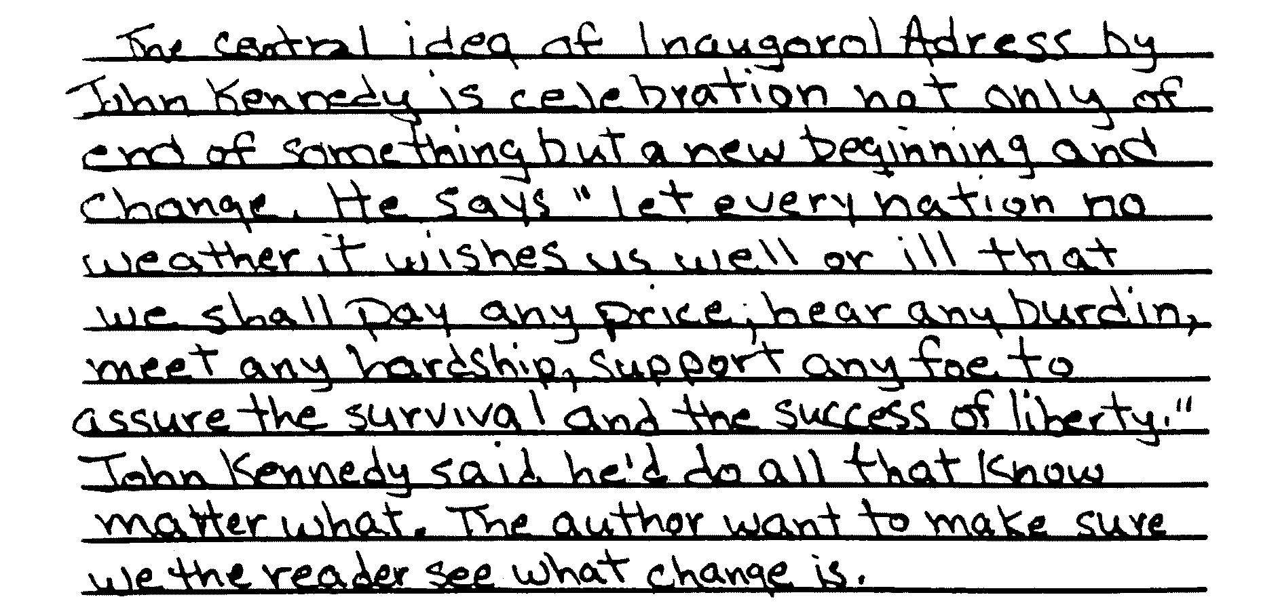
Anchor Paper – Part 3 – Level 2 – A

Slide 46
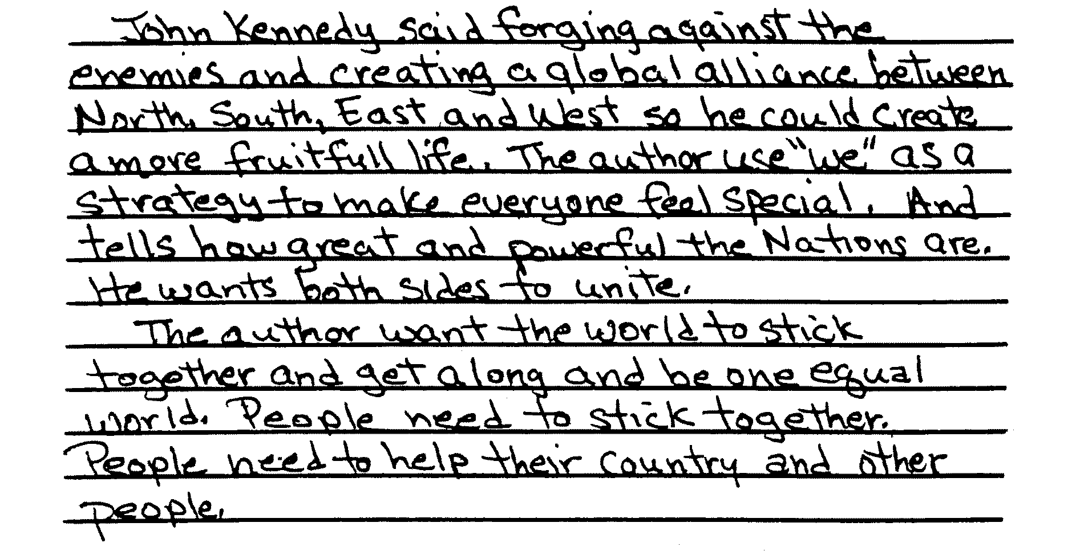
Anchor Paper – Part 3 – Level 2 – A
(continued)

Slide 47
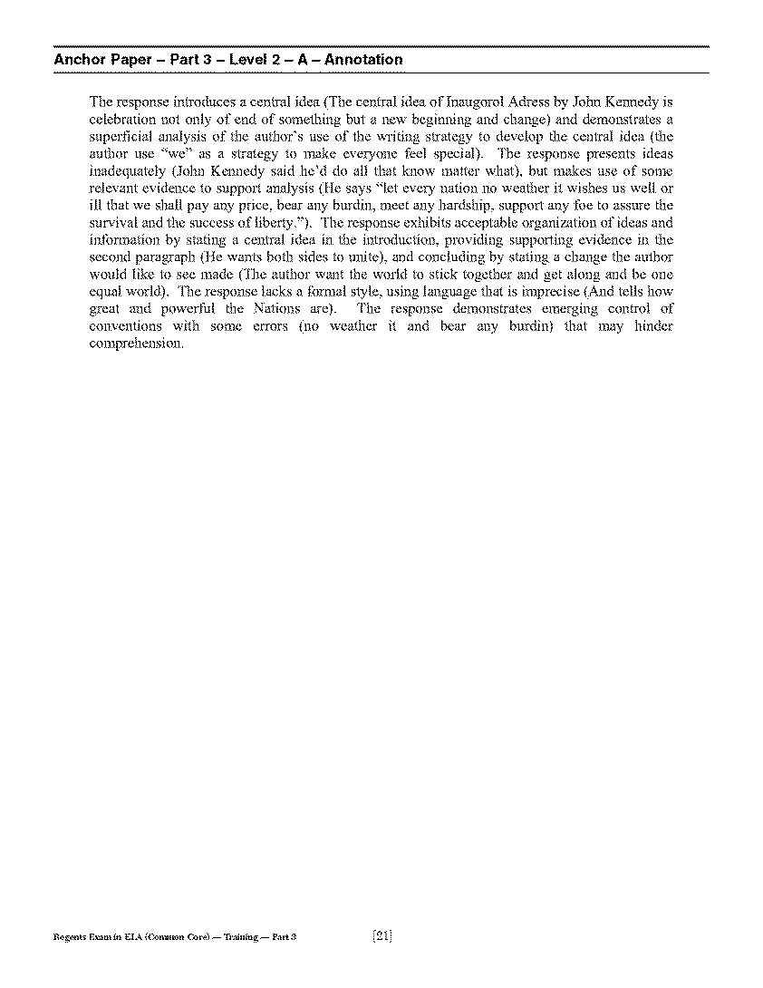
Anchor Paper- Part 3- Level 2- A Annotation
Please refer to page 21 of your Teacher’s Packet.

Slide 48
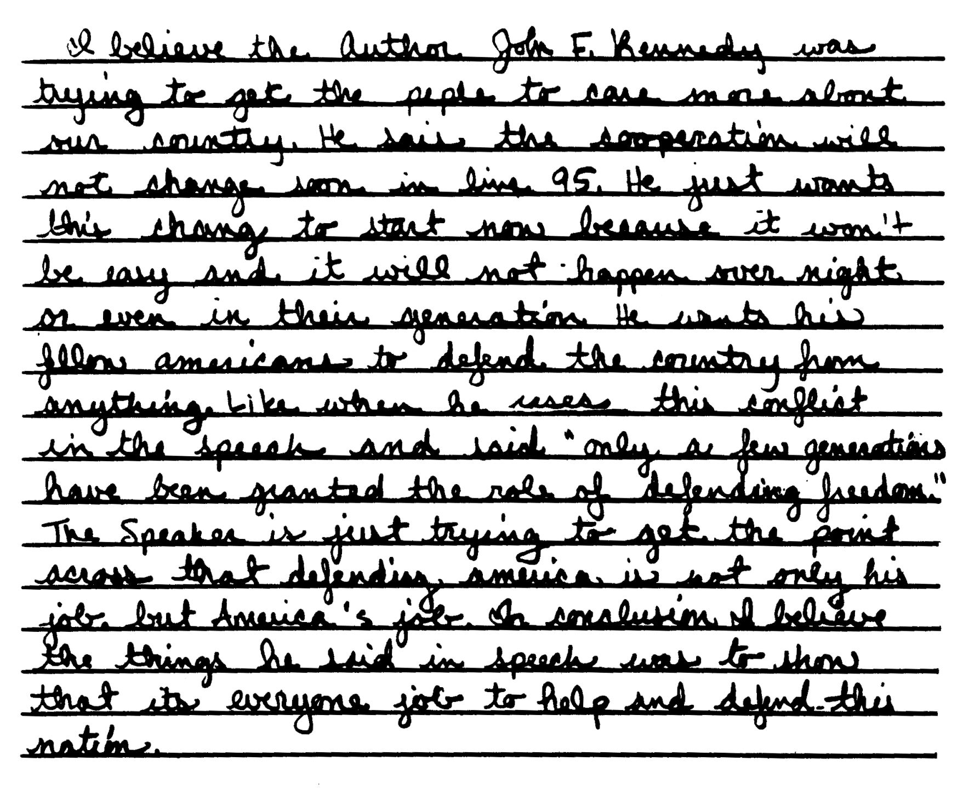
Anchor Paper – Part 3 – Level 2 – B

Slide 49
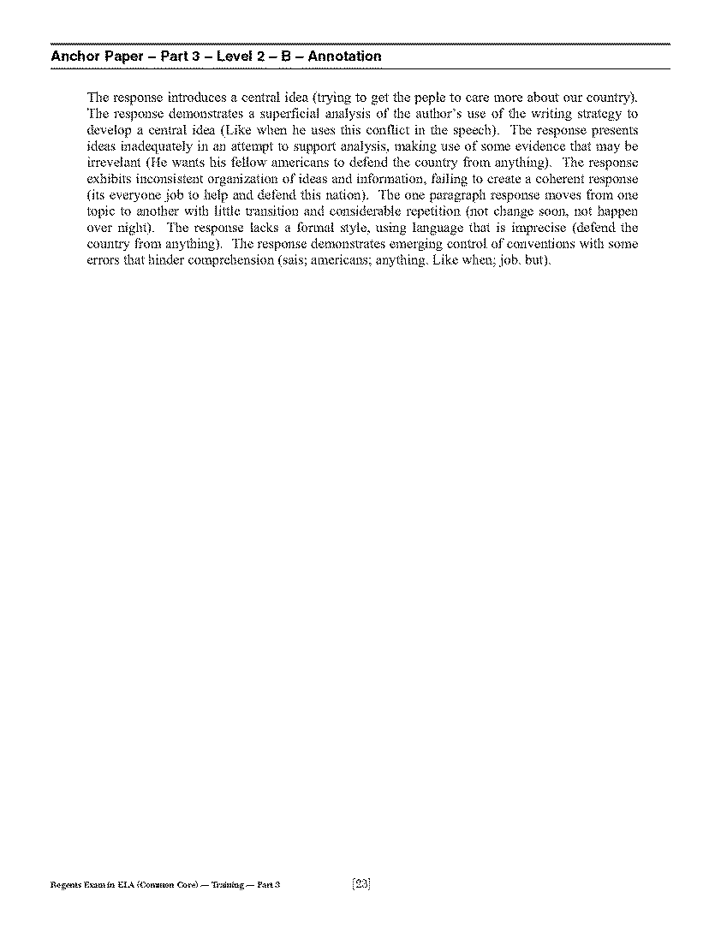
Anchor Paper- Part 3- Level 2- B
Annotation
Please refer to page 23 of your Teacher’s Packet.

Slide 50
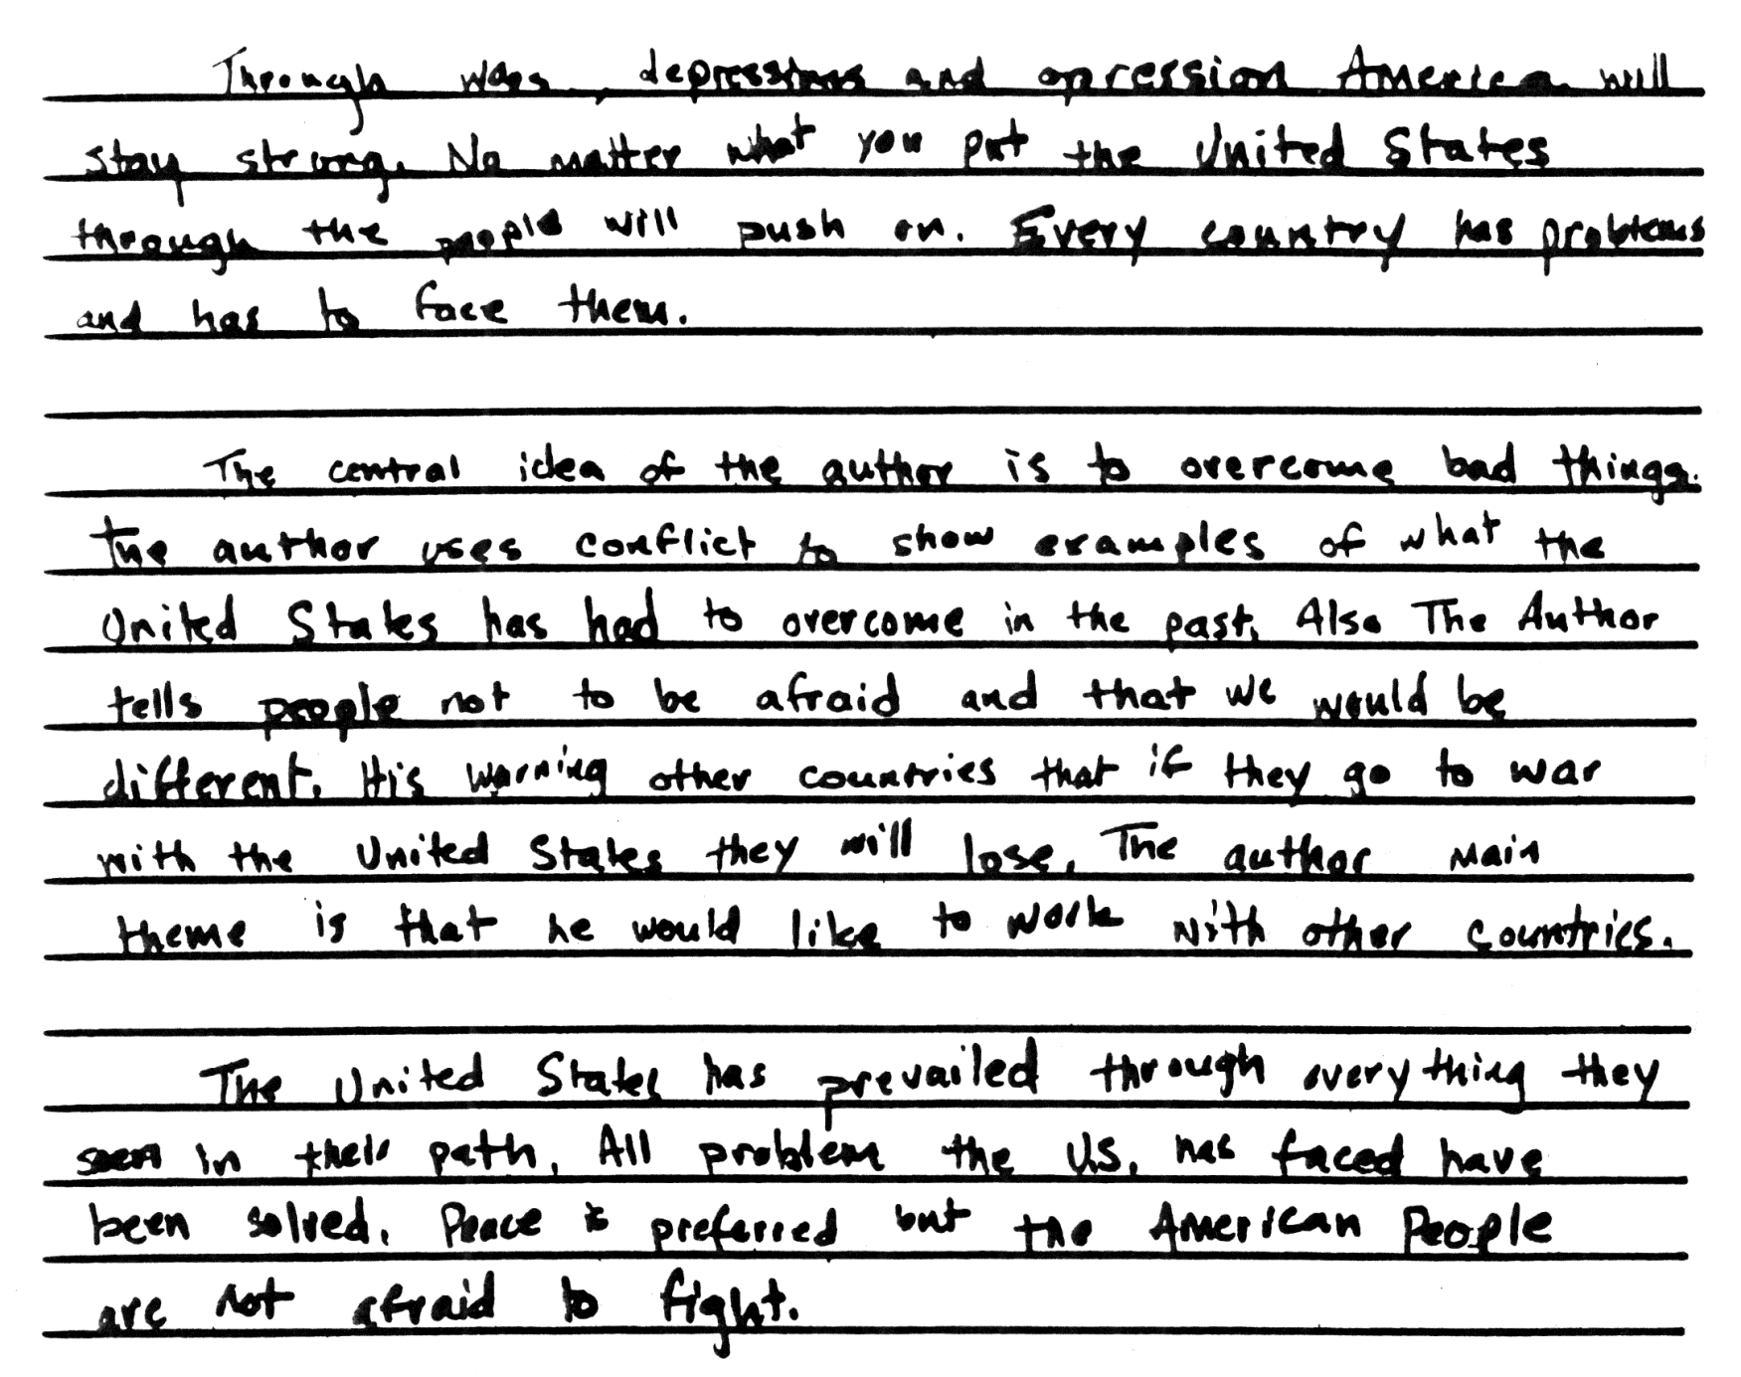
Anchor Paper – Part 3 – Level 2 – C

Slide 51
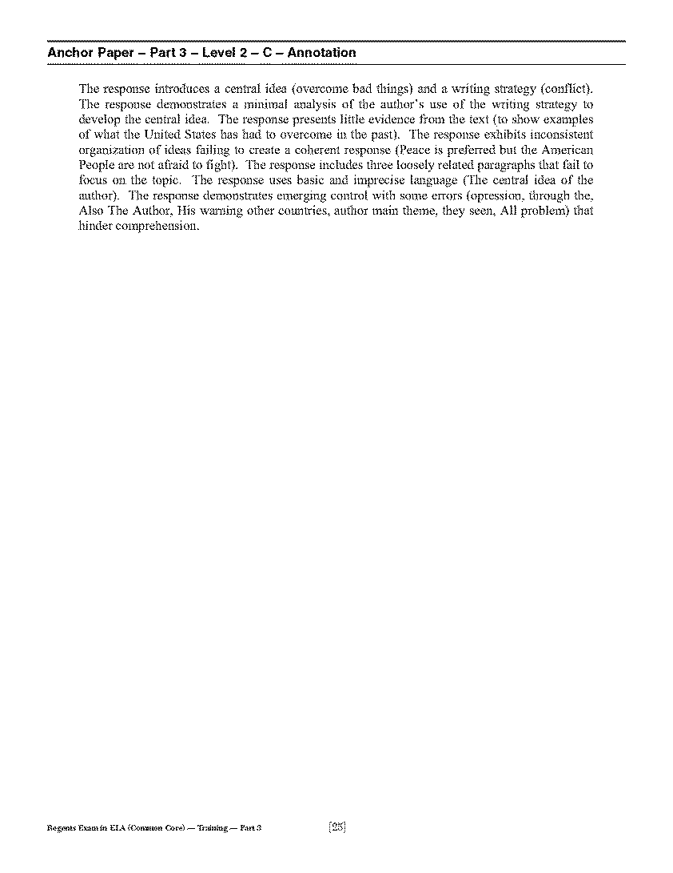
Anchor Paper- Part 3- Level 2- C Annotation
Please refer to page 25 of your Teacher’s Packet.

Slide 52
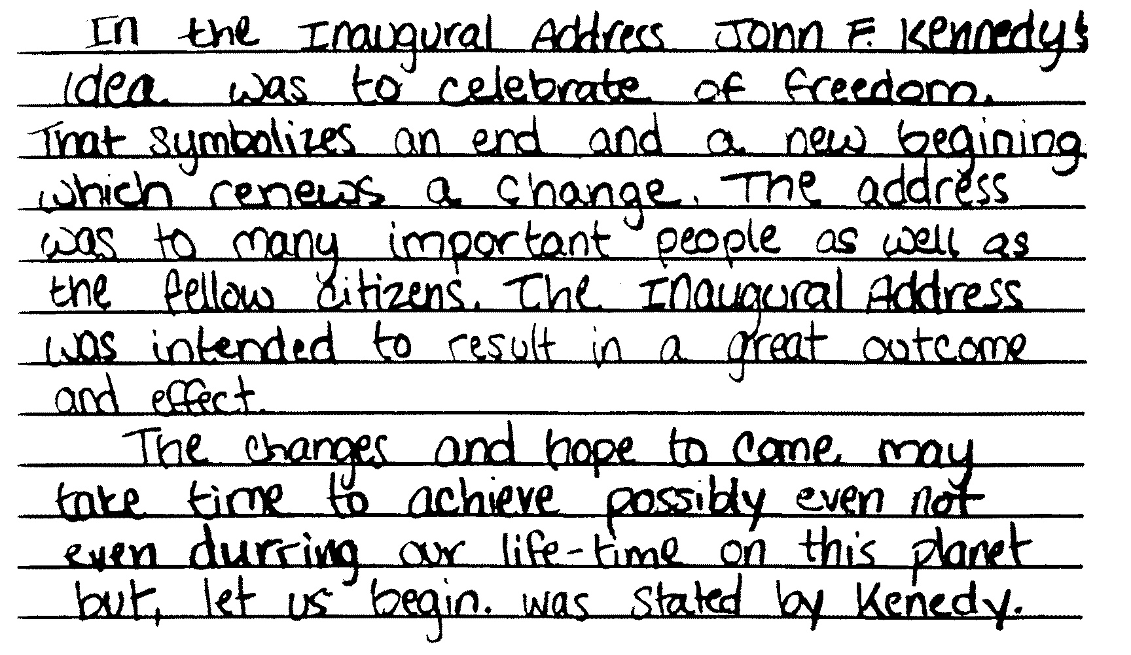
Anchor Paper – Part 3 – Level 1 – A

Slide 53
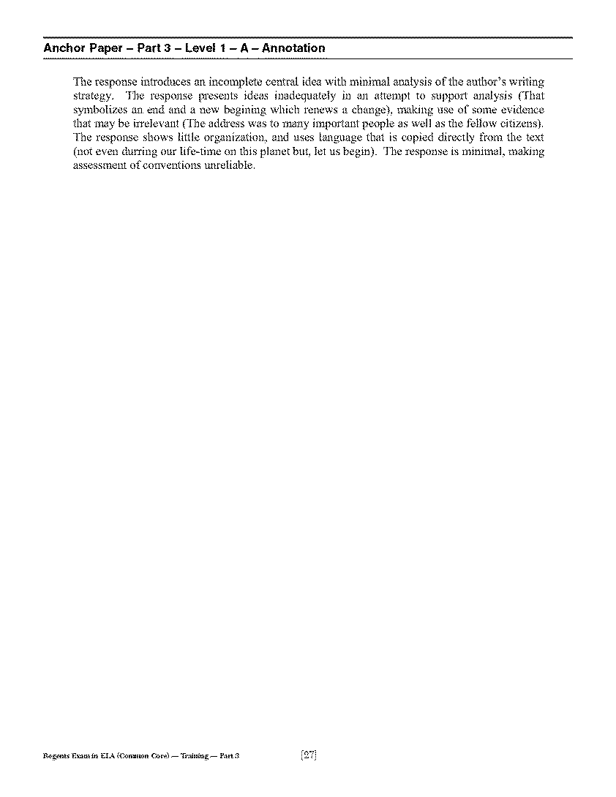
Anchor Paper- Part 3- Level 1- A Annotation
Please refer to page 27 of your Teacher’s Packet.

Slide 54
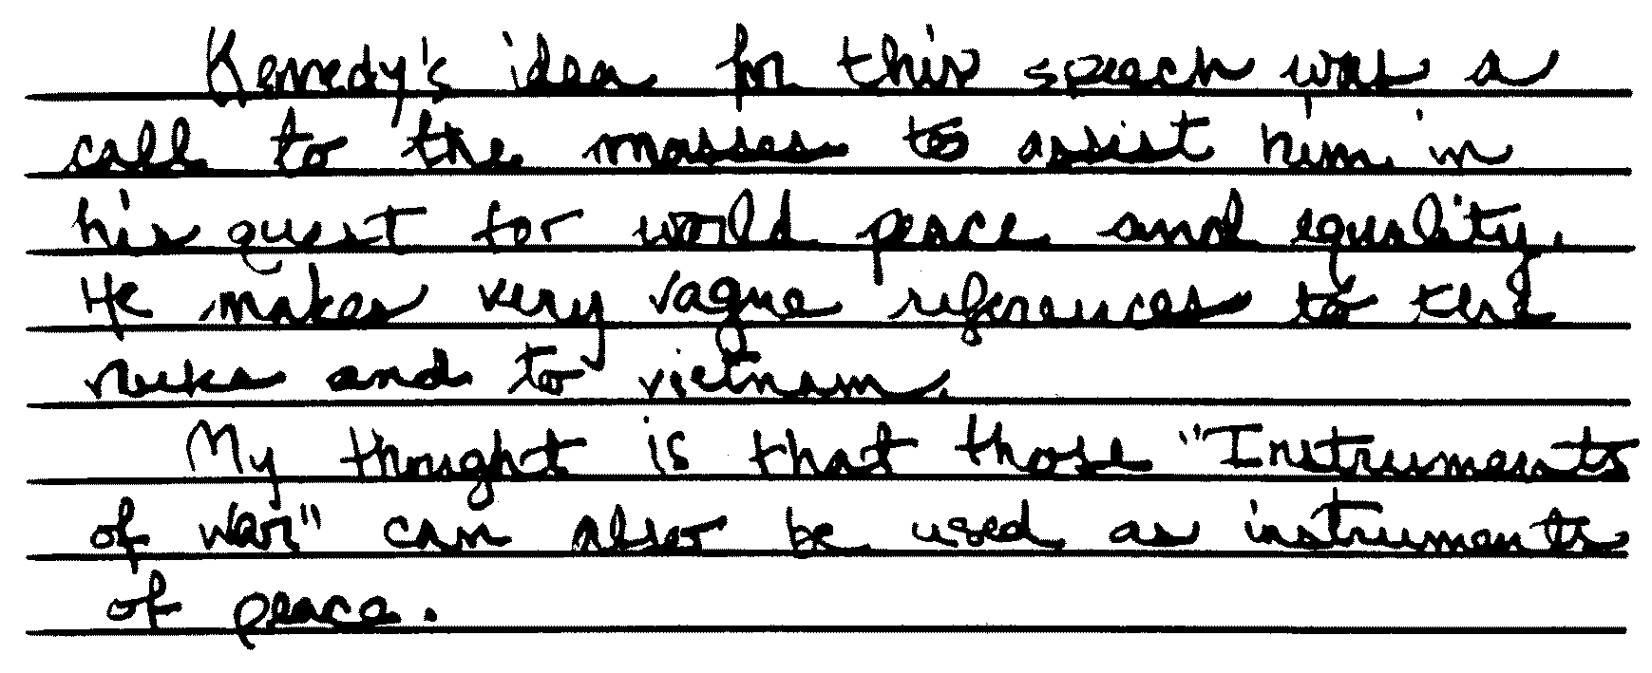
Anchor Paper – Part 3 – Level 1 – B

Slide 55
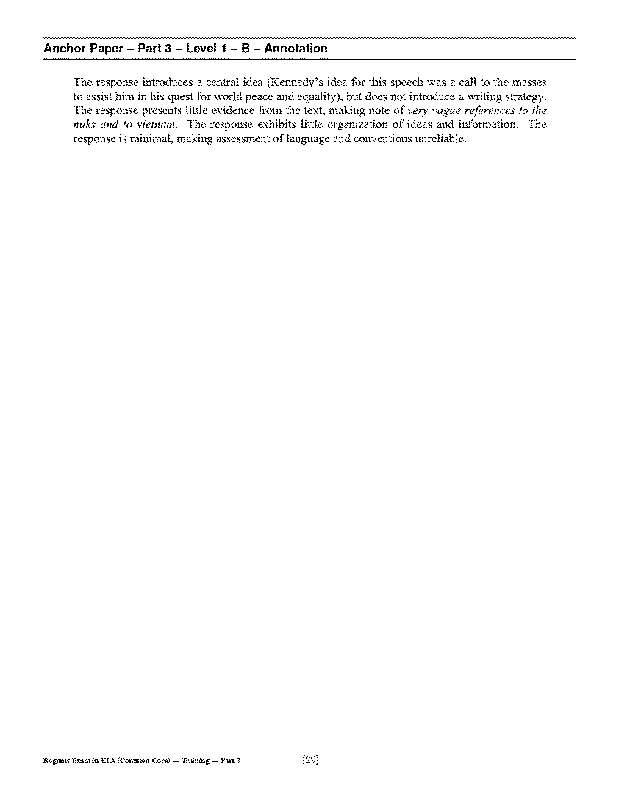
Anchor Paper- Part 3- Level 1- B Annotation
Please refer to page 29 of your Teacher’s Packet.

Slide 56
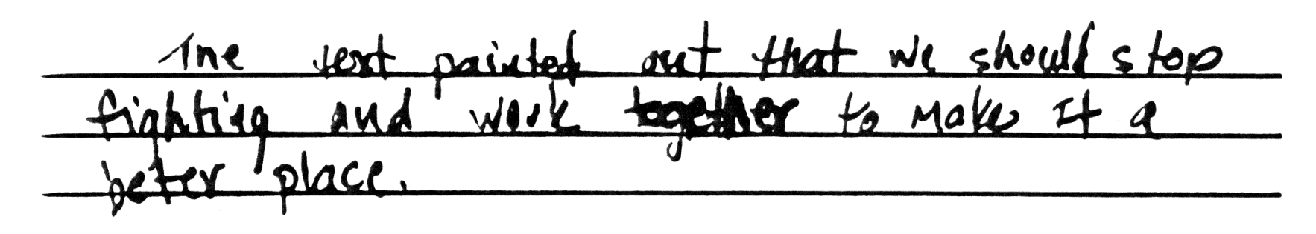
Anchor Paper – Part 3 – Level 1 – C

Slide 57
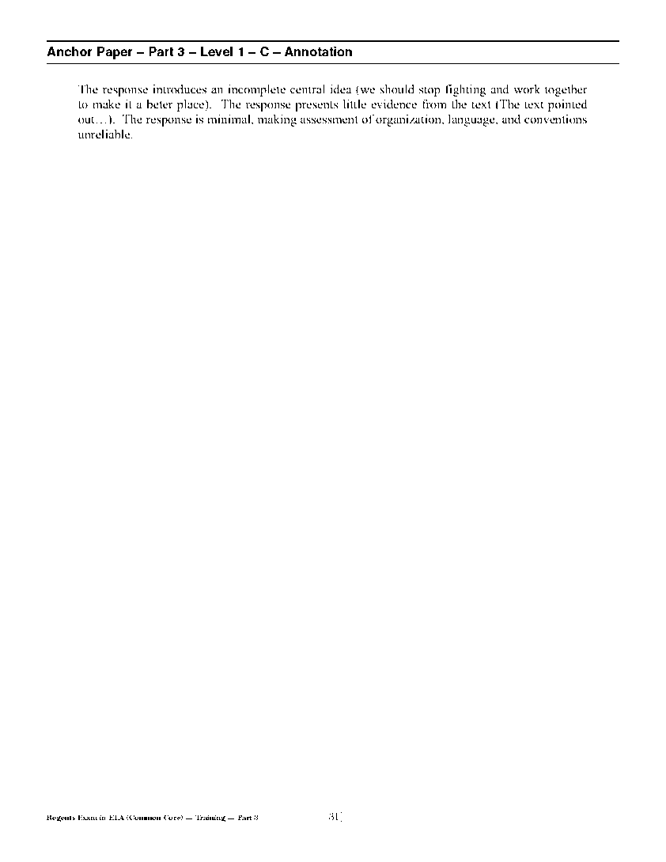
Anchor Paper- Part 3- Level 1- C Annotation
Please refer to page 31 of your Teacher’s Packet.

Slide 58
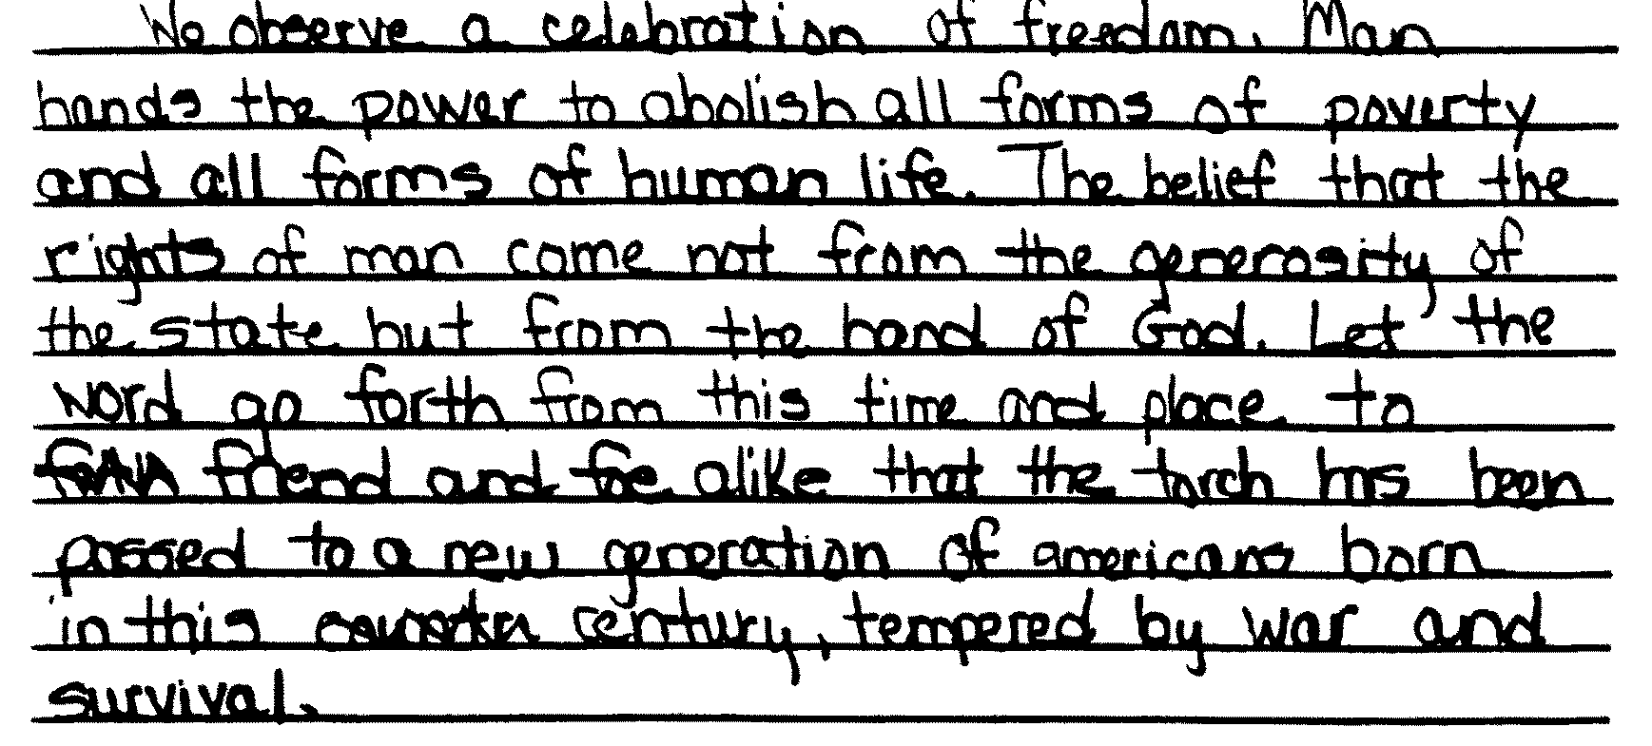
Anchor Paper – Part 3 – 0

Slide 59
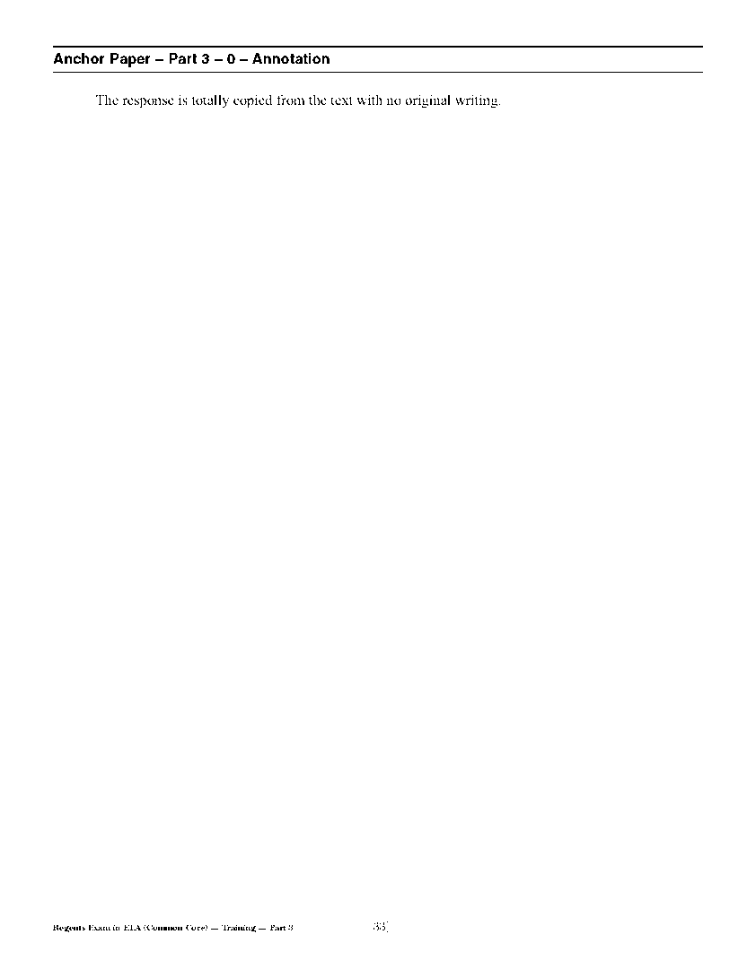
Anchor Paper- Part 3- 0
Annotation
Please refer to page 33 of your Teacher’s Packet.

Slide 60
Practice Papers
(Please refer to page 34 of your Teacher’s Packet.)

Slide 61
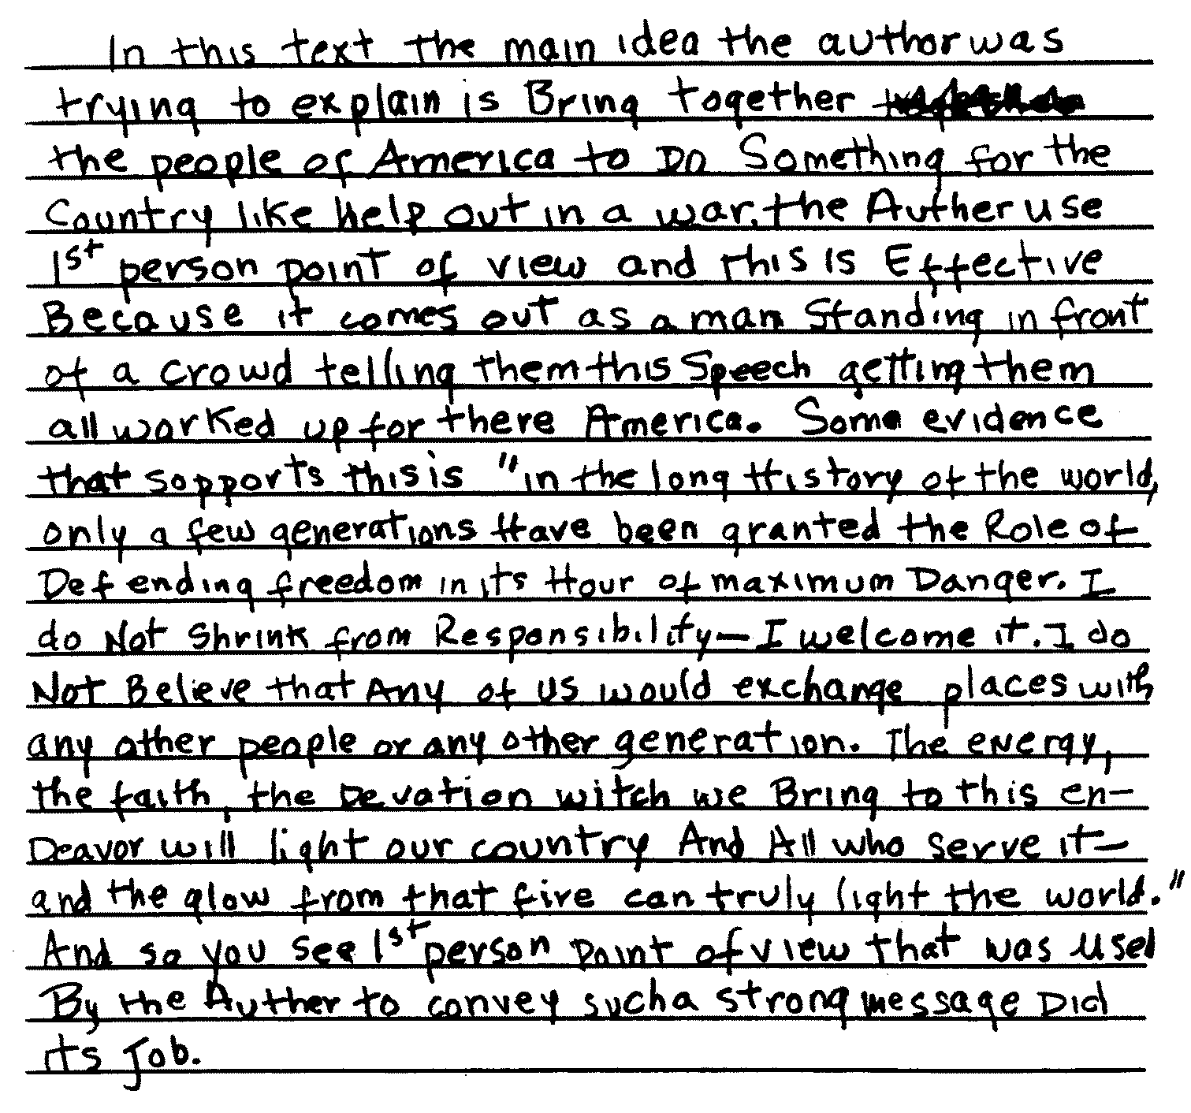
Practice Paper – Part 3 – A

Slide 62
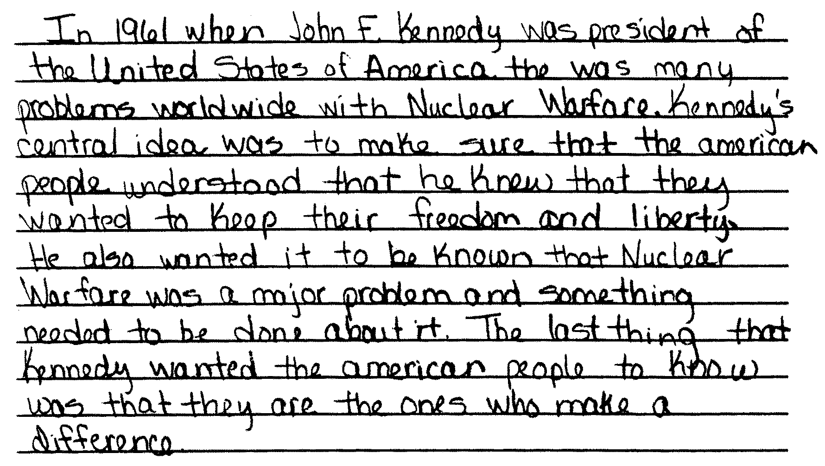
Practice Paper – Part 3 – B

Slide 63
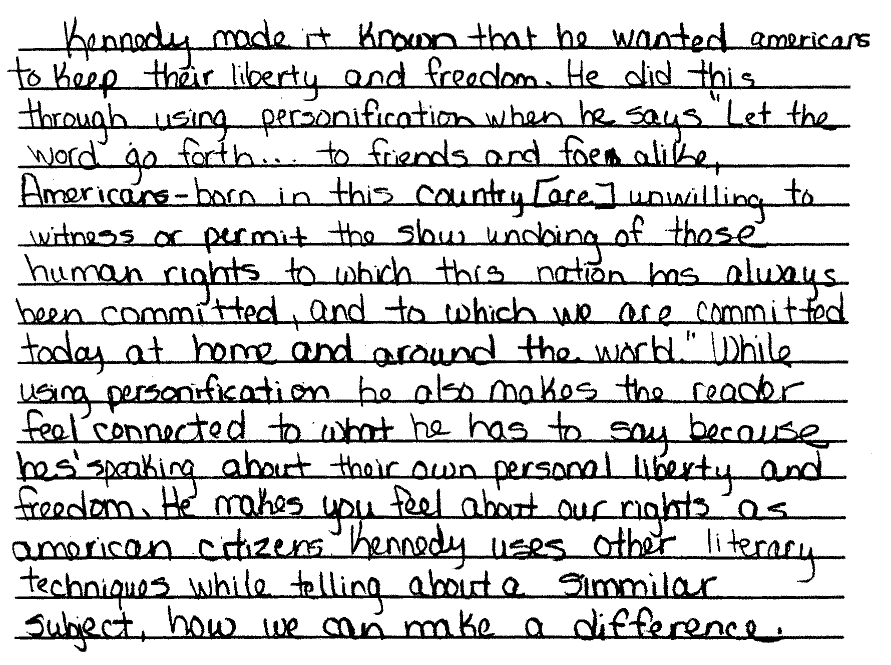
Practice Paper – Part 3 – B
(continued)

Slide 64
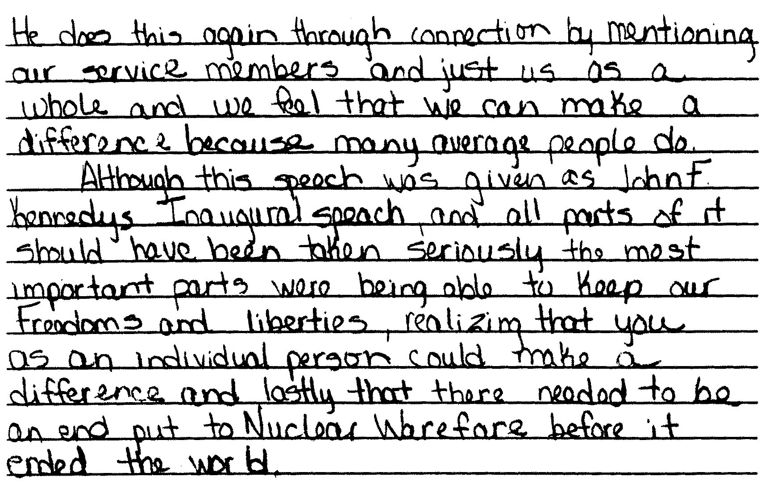
Practice Paper – Part 3 – B
(continued)

Slide 65
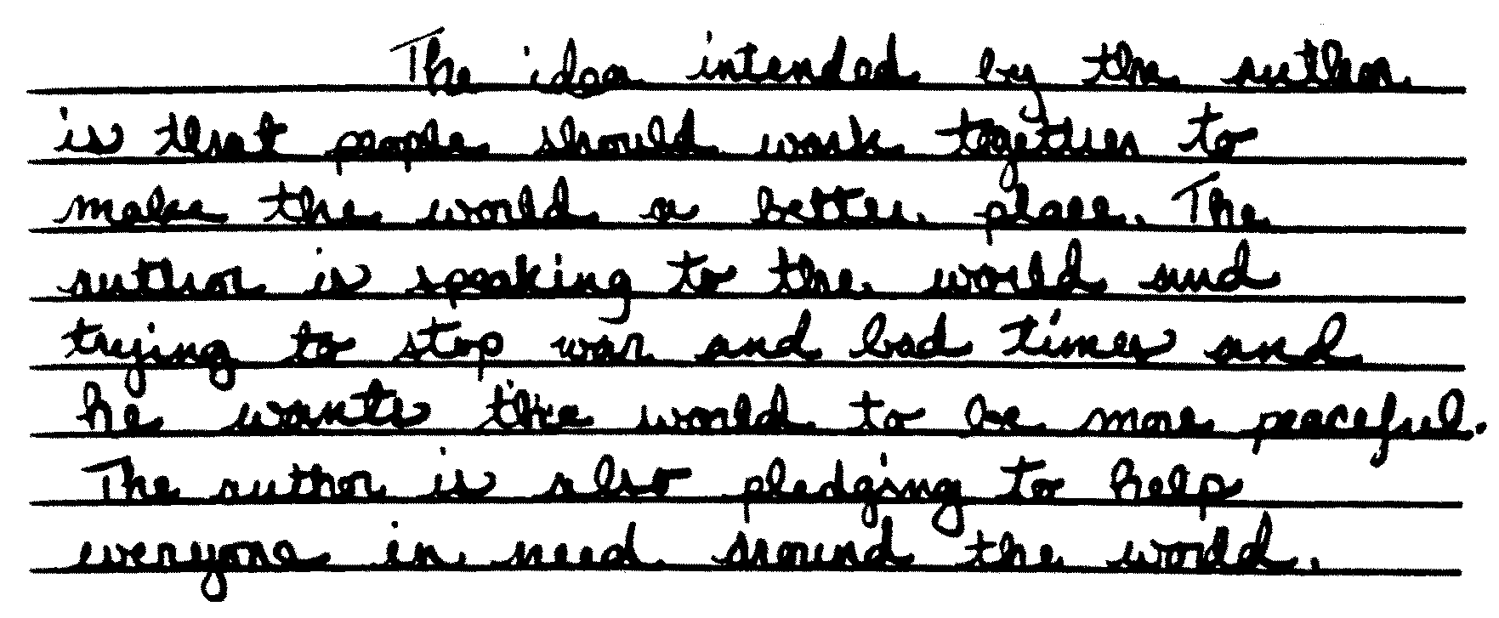
Practice Paper – Part 3 – C

Slide 66

Practice Paper – Part 3 – D

Slide 67

Practice Paper – Part 3 – D
(continued)

Slide 68

Practice Paper – Part 3 – D
(continued)

Slide 69

Practice Paper – Part 3 – E

Slide 70

Practice Paper – Part 3 – E
(continued)

Slide 71
Practice Paper
Annotations

Slide 72

Practice Paper- Part 3- A
Annotation
Please refer to page 41 of your Teacher’s Packet.

Slide 73

Practice Paper- Part 3- B
Annotation
Please refer to page 42 of your Teacher’s Packet.

Slide 74

Practice Paper- Part 3- C
Annotation
Please refer to page 43 of your Teacher’s Packet.

Slide 75

Practice Paper- Part 3- D
Annotation
Please refer to page 44 of your Teacher’s Packet.

Slide 76

Practice Paper- Part 3- E
Annotation
Please refer to page 45 of your Teacher’s Packet.

Slide 77
Thank You!
Questions regarding this webcast may be forwarded to
emscassessinfo@mail.nysed.gov

